Slide 1
Understanding Cravings And how to manage them
Bob Phillips, D.BH
New Mexico Rehabilitation Center
Roswell, NM
November
2022

Slide 2
Key Elements in the Development
of Craving
Cravings are both natural and learned experiences that motivate behavior. Much like hunger motivates food-seeking, thirst motivates water-drinking and loneliness motivates us to seek companionship.
A stimulus is anything that evokes a response in humans. We react to some stimuli automatically, without ‘learning’’ (like moving your hand away from a hot stove if you touch it), Other stimuli require learning or ‘conditioning’ to respond to them.
For example, listening to a piece of music while using a drug can cause you think about, or having a craving for the drug when hear the music again.
Natural or Unconditioned
Responses
If the outcome of a response is rewarding, we tend to repeat behaviors that expose us to the stimulus, so we can experience those rewards again.
Stimulus
Response
Consequence
Rewards can be positive or negative. A positive reward ADDs something to our experience (feeling good). A negative reward SUBTRACTs something unpleasant from our experience (e.g., we take a drink and it takes away shyness).
Learned
or Conditioned
Responses

Slide 3
Ivan Pavlov was a Russian physiologist. He and his dogs won a Nobel Prize 1927 for learning that the sound of a metronome meant that food was coming (though its often remembered as a bell, or lightbulb).
We want to understand how sights, smells, sounds, and places can influence our behavior. These things are called cues, contexts or simply triggers. In drug addiction, people experience cues, triggers, contexts and drugs around the same time and form mental links or associations between the triggers and the drugs.
These mental links can elicit cravings and motivate people to seek out drugs. Much like Pavlov’s dogs learned that the sound of a metronome meant that food was coming and began to salivate or crave the food when they heard the sound. See the diagrams on the next page.
Scientists study how these mental links can motivate people to seek out drugs even if they are trying to quit. See the slide that follows that describes prediction for one explanation.
By studying the brain as these mental links are being formed or broken, researchers are learning about one of the things that keeps people from breaking their addictions, and they are improving the therapies available to help people who are addicted to drugs if they are trying to quit.

Slide 4
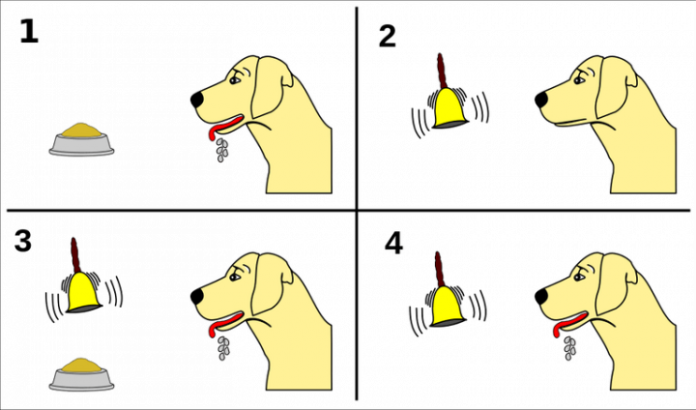
1. The dog naturally (or unconditionally) responds to the sight and smell of food. Food is an unconditioned stimulus causing an unconditioned response. 2. The dog initially makes no response to the bell (a neutral stimulus). BUT when you pair (3) the unconditioned stimulus (the food) with the bell, then the dog “learns” to associate the two. 4. The dog now responds to the bell (now a conditioned stimulus) in the same way it responded to the food. The response to the bell is a conditioned response.

Slide 6
Your Predicting Brain
Remember a time you had been working hard in the sun and became very thirsty. In response you drank a cool clear glass of water, and almost immediately felt relief from your thirst.
Its impossible that the water itself quenched your thirst so quickly since it takes 20 minutes on average for water to be absorbed and distributed in your blood stream.
Based on previous experiences your brain predicts that relief is on its way, and your mind and body respond* accordingly.
The same predictions occur when you see or smell a drug, or even when you are in the same or similar situations where drugs or alcohol were used.
*These responses include changes in your metabolism, heartrate, release of neurotransmitters, secretion of digestive enzymes and feelings of euphoria among many others.
In unfamiliar situations your brains’ predictions and your body’s responses are weaker…
…weaker predictions and responses can account for why drugs may feel different, and an overdose is significantly more likely in unfamiliar situations.

Slide 7
What cues, contexts or triggers do you associate with cravings and drug or alcohol use?
People
Places
Objects
Thoughts and Feelings
Moods
Situations
Foods
Music
Seeing/smelling drugs or alcohol themselves
Needles
_________________________________
_________________________________
_________________________________

Slide 8
Extinguishing Cravings
Understand that cravings are normal responses to what we feel we want or believe we need.
Cravings are usually brief experiences, but they can happen repeatedly
Cravings do not keep growing more intense but rise, peak and then fall.
Cravings are made stronger by ‘giving in’ to them
Cravings are made weaker and are eventually extinguished by resisting the urge to ‘give in; to them.
In the very short term, it is usually best to avoid the triggers that eilcit cravings, but…
In the long run it best to learn ways to cope with cravings and master the triggers that cause them.
Cravings can be safely “extinguished” by gradual exposure to triggers that range from weaker to stronger while learning ways of coping and mastery at each step.

Slide 9
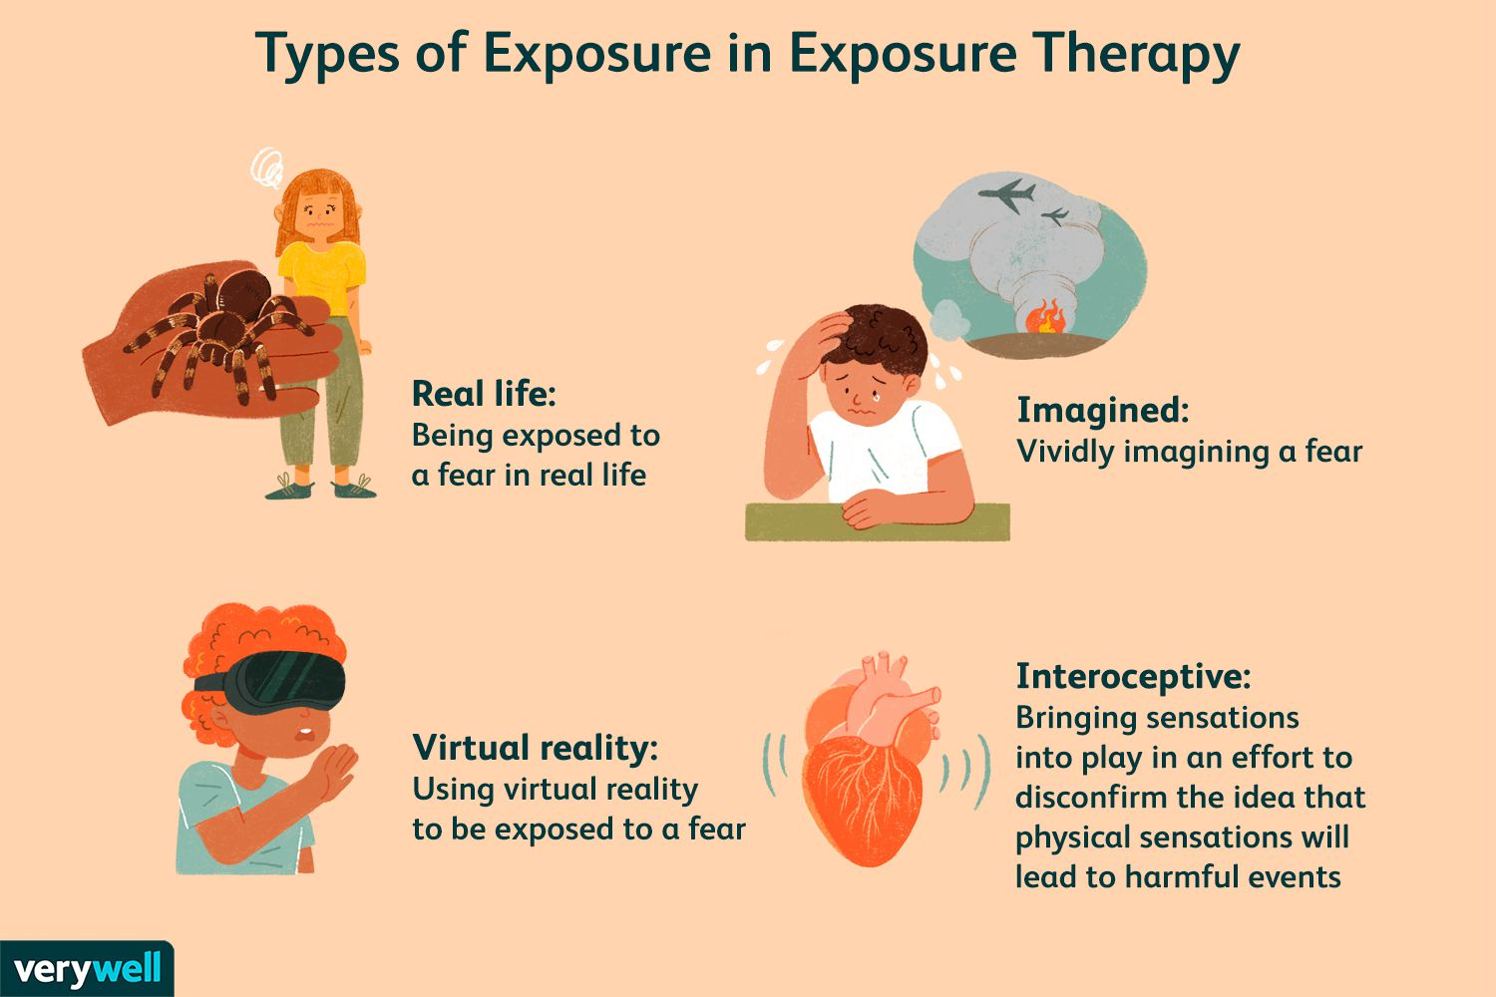
Examples of “Exposures”

Slide 10
4 Steps in the Coping and Mastery of Cravings See details for these steps on the next pages…
Recognize high-risk situations and your reactions to them. Utilize self-monitoring.
Become aware of your thoughts, feelings and beliefs about the situation and learn to apply Helpful Thinking.
1
2
Have a plan – in advance- to escape or leave the situation if you are aware your coping may not be adequate.
Implement effective coping strategies that you have learned and practiced ahead of time.
4
3

Slide 11
Recognizing High Risk Situations
HIGH-RISK EVENTS OR ‘TRIGGER’ SITUATIONS | TYPCALLY USED IN THIS SITUATION? | RATE HOW CONFIDENT YOU ARE NOW ABOUT YOUR ABILITY TO NOT USE OR REFUSE TO USE IN EACH SUTUATION 0 = Not t all confident, 100 =completely sure you could resist
UNPLEASENT EMOTIONS (when angry, frustrated, sad or anxioius | Yes No | 0 10 20 30 40 50 60 70 80 90 100
PHYSICAL DISCOMFORT (when feeling ill or in pain) | Yes No | 0 10 20 30 40 50 60 70 80 90 100
PLEASANT EMOTIONS (when enjoying yourself, or feeling happy) | Yes No | 0 10 20 30 40 50 60 70 80 90 100
TESTING CONTROL (when you started thinki9ng you could handle drinking or using) | Yes No | 0 10 20 30 40 50 60 70 80 90 100
HAVING URGES or CRAVINGS (when remembering, or seeing alcohol or other drugs; or when around people, places or things that remind you of them) | Yes No | 0 10 20 30 40 50 60 70 80 90 100
CONFLICTS WITH OTHERS (after an argument or not getting along with someone) | Yes No | 0 10 20 30 40 50 60 70 80 90 100
SOCIAL PRESSURE TO USE (when someone offers you a drink or drug) | Yes No | 0 10 20 30 40 50 60 70 80 90 100
PLEASANT TIMES WITH OTHERS (when out with friends, or a party) | Yes No | 0 10 20 30 40 50 60 70 80 90 100

Slide 12
PROMOTE HELPFUL THINKING
The ways we think about ourselves and the things that have happened to us shape our feelings and behaviors
All situations make people feel a certain way, but an important influence on our actions and emotions is what we think about the situation, and what we say to ourselves.
THOUGHT
That looks to good right now. I can’t turn
it down
EMOTION
Anxiety
A Trigger Event or High-Risk Situation
(for example, being offered a drink or drug)
THOUGHT
Why can’t I be strong right now
EMOTION
Frustration
THOUGHT
I have a good excuse for saying ‘no’
EMOTION
Relief

Slide 13
Four Steps to Promote Helpful Thinking
Persons with addictions often have distressing thoughts when they experience high-risk situations and cravings. Learning to change your thinking before, during and after these situations occur can be extremely beneficial to your recovery, and in successfully managing cravings and high-risk situations.
(2) Identify unhelpful thoughts about the situation and its triggers
(1) Identify high-risk situations and their Triggers
(4) Rehearse helpful thoughts and practice them regularly
(3) Identify alternative, Helpful thoughts. Notice changes in your reactions.

Slide 14
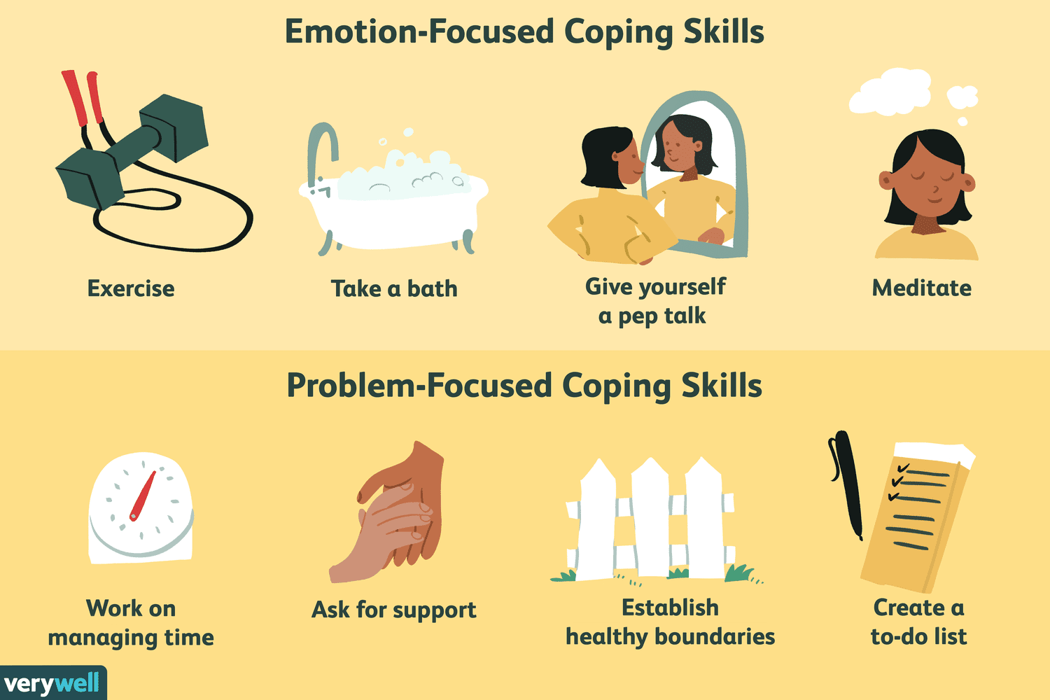
Develop, practice and use effective coping skills
Dispute negative thinking and self-talk
Promote helpful thinking and self-talk
Call or talk to a trusted advisor
Develop a Social Support System
Regular practice of stress-relief breathing
Prayer or meditation
Practice good nutrition
Consider neuro-nutrient supplements
Get regular exercise
Get regular sleep. Get help for this if you are are not sleeping well
Participate regularly in support groups; especially 12-step groups
Learn about and consider Medication Assisted Treatments
Learn and Practice URGE SURFING (see next page)

Slide 15
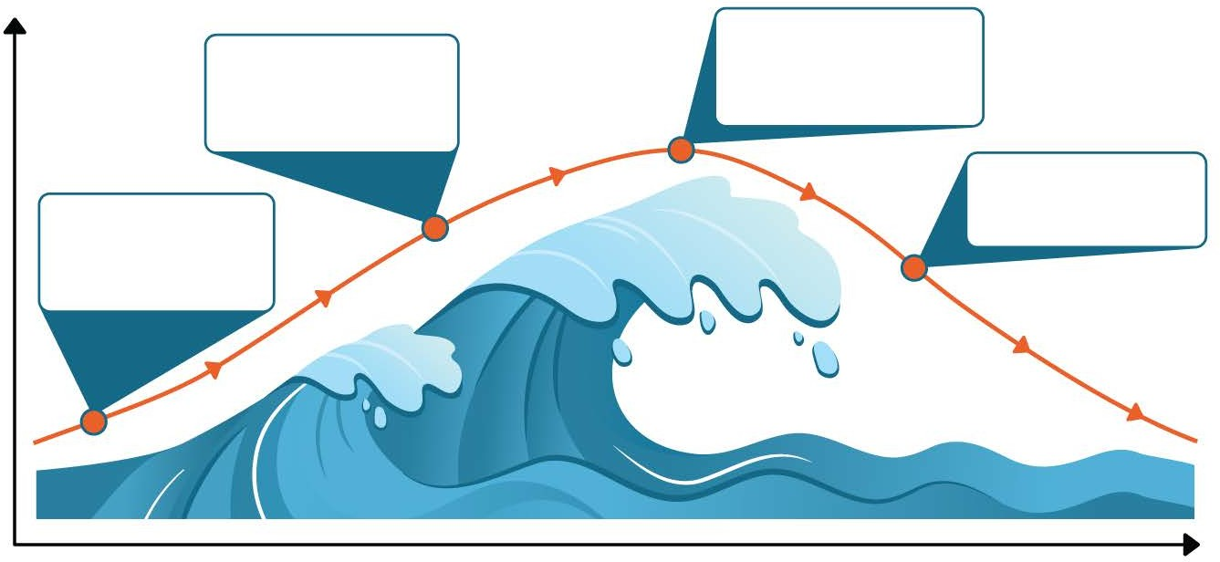
URGE SURFING
Urge surfing is a technique for managing your unwanted behaviors. Rather than giving in to an urge, you will ride it out, like a surfer riding a wave. After a short time, the urge will pass on its own. This technique can be used to stop or reduce drug and alcohol use, emotional reactions such as “blowing up” when angry, gambling, and other unwanted behaviors.
How to Practice Urge Surfing
Acknowledge you are having an urge.
2. Notice your thoughts and feelings without trying to change or suppress them.
Note: It is normal to feel some discomfort during an urge.
Remind yourself…
Urges are natural reactions to addictions and habits.
Some discomfort is okay. I don’t have to
change it
An urge is a feeling, not a “must.” I can
have this feeling and choose not to act.
. An urge is temporary. Like any other
feeling, it will pass on its own.
INTENSITY OF URGE
PEAK: The urge reaches its most intense point. It may feel as if the urge will never go away.
RISE: The urge becomes more intense. This may happen gradually or very suddenly.
FALL: The urge loses intensity and eventually fades away.
TRIGGER: An urge is triggered by a person, place, thought, feeling, or something else.
Graphic Provided by TherapistAid.com
TIME

Slide 16
Self-monitor your Cravings
Date and Time of Trigger Situation | Who are you with? Where are you right now? | What kind of mood are you in right now? | Intensity of your craving (scale from 1-100) | What are you thinking or telling yourself right now? | Challenge your thinking; Use urge surfing, or other strategy | Re-rate the intensity of your craving (scale 1-100) | Lessons learned?

Slide 17
SOMETIMES WE’RE RESPONSIBLE FOR THINGS NOT BECAUSE THEY’RE OUR FAULT, BUT BECAUSE WE’RE THE ONLY ONES WHO CAN CHANGE THEM.
Lisa Feldman Barrett, PhD

Slide 18
Useful References…
Skills for Psychological Recovery
www.ptsd.va.gov/professional/treat/type/skills_psych_recovery_manual.asp
The Anti-Depressant Skills Workbook
https://www.sfu.ca/carmha/publications/antidepressant-skills-workbook.html
Mindfulness Based Relapse Prevention for Addictive Behaviors
https://www.guilford.com/books/Mindfulness-Based-Relapse-Prevention-for-Addictive-Behaviors/Bowen-Chawla-Grow-Marlatt/9781462545315
7 ½ Lessons About The Brain (2020) Lisa Feldman Barrett. Mariner Books/Harper Collins
https://sevenandahalflessons.com/notes/Extended_notes_for_Seven_and_a_Half_Lessons_About_the_Brain

