Slide 1
SPIRITUALITY & RESTORATIVE JUSTICE Introduction
BALAZS BATYKA SILVER CITY INSTITUTE, AUGUST 2023

Slide 2
Prayer to the Great Mystery
I humbly acknowledge my ignorance to be unable to encompass the knowledge and wisdom to fully understand the existence of a power and creative force which created our Universe and our own Mother Earth. However, I am sincerely grateful to be a tiny part of that masterful creation, where the Earthly evidence is clearly displayed by the inherent harmony and balance in the natural order in Nature.
On our planet that Natural Order is clearly observable by the harmony and interconnected purpose of all that is created, plants, animals, sea dwelling lifeforms and even the balanced geology of Mother Earth. In fact, when that is acknowledged and all our relations are seen as part of the whole spiritual purpose and mutual harmony, we humans might begin to recognize our spiritual purpose. Fort that I am truly grateful and humbled by being part of that process.
Which in turn begs the question of what is the purpose for humankind as an element together and individually.

Slide 3
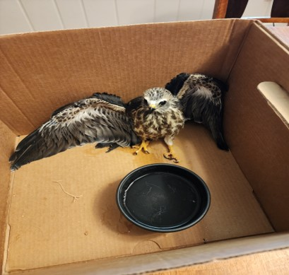
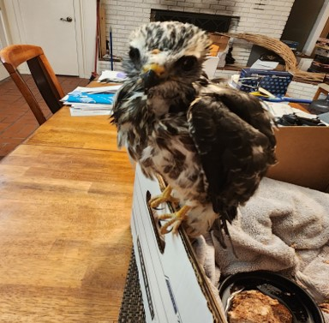
A Moment of spiritual connection
Desperate & Weak
Finally Some Energy

Slide 4
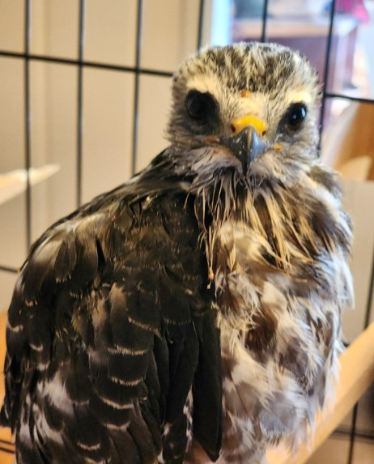
Thank You Kind Friends

