Slide 1
Addressing Relapse Through Evidenced-based Management of Anxiety, Trauma, Sleep, & Depression
Bob Phillips, D. BH, LMSW, LADAC
Behavioral Health Consultant
2023

Slide 2
Lapse Slip Reuse Relapse Recurrance Prolapse Setback
Most studies of recurrence in addictions have been based on treatment samples rather than population samples.
Definitions and rates of recurrence vary widely based on follow-up interval and definition.
Most (about 80%) recurrence occurs early following tx. By 3-4 months 40-60% of patients will have some recurrence and 70-80% will recur by the end of 1 year.
From across the literature at least two things are clear:
- Lapses are distinct from Relapses
- Do the hard work early when both risks and motivation are highest.

Slide 3
Recognizing High Risk Situations
HIGH-RISK EVENTS OR ‘TRIGGER’ SITUATIONS | TYPCALLY USED IN THIS SITUATION? | RATE HOW CONFIDENT YOU ARE NOW ABOUT YOUR ABILITY TO NOT USE OR REFUSE TO USE IN EACH SUTUATION 0 = Not t all confident, 100 =completely sure you could resist
UNPLEASENT EMOTIONS (when angry, frustrated, sad or anxioius | Yes No | 0 10 20 30 40 50 60 70 80 90 100
PHYSICAL DISCOMFORT (when feeling ill or in pain) | Yes No | 0 10 20 30 40 50 60 70 80 90 100
PLEASANT EMOTIONS (when enjoying yourself, or feeling happy) | Yes No | 0 10 20 30 40 50 60 70 80 90 100
TESTING CONTROL (when you started thinking you could handle drinking or using) | Yes No | 0 10 20 30 40 50 60 70 80 90 100
HAVING URGES or CRAVINGS (when remembering, or seeing alcohol or other drugs; or when around people, places or things that remind you of them) | Yes No | 0 10 20 30 40 50 60 70 80 90 100
CONFLICTS WITH OTHERS (after an argument or not getting along with someone) | Yes No | 0 10 20 30 40 50 60 70 80 90 100
SOCIAL PRESSURE TO USE (when someone offers you a drink or drug) | Yes No | 0 10 20 30 40 50 60 70 80 90 100
PLEASANT TIMES WITH OTHERS (when out with friends, or a party) | Yes No | 0 10 20 30 40 50 60 70 80 90 100

Slide 4
The Four Horsemen of the Apocalypse
ANXIETY
TRAUMA
SLEEP
DEPRESSION

Slide 5
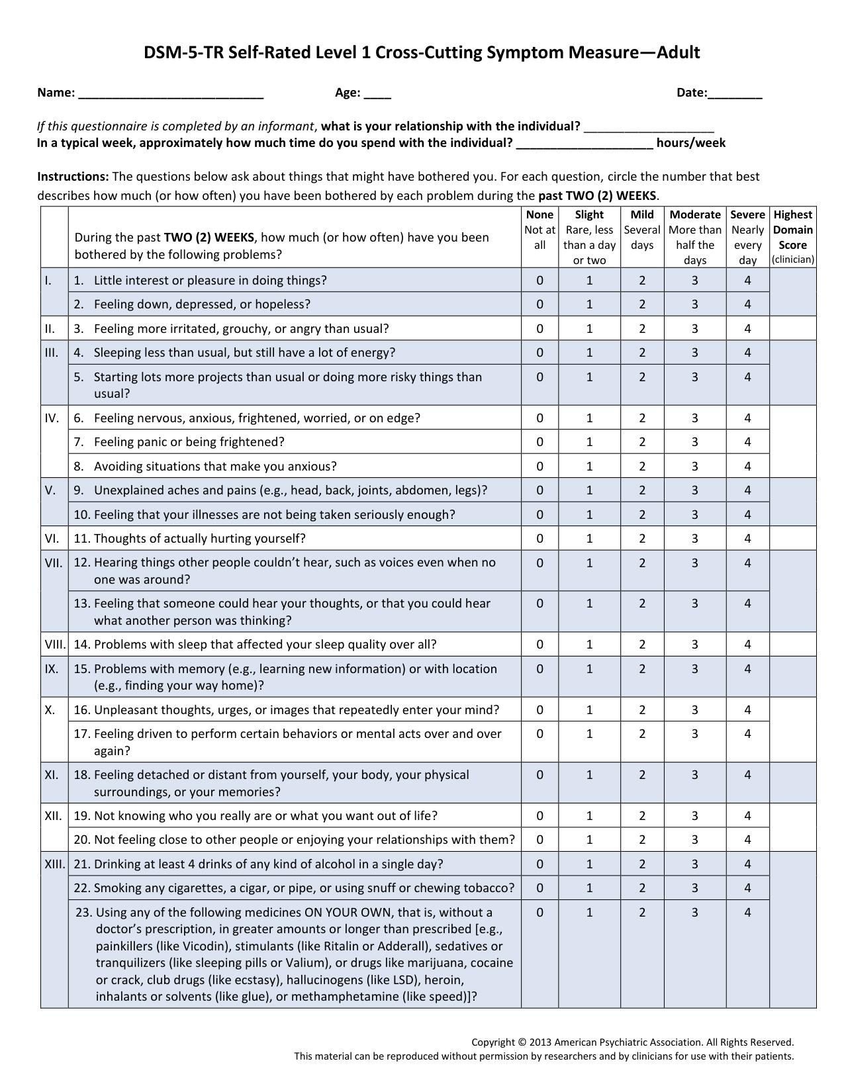
SCREENING
The DSM-5-TR Cross Cutting Symptom Measure
Psychiatry.org - DSM-5-TR Online Assessment Measures

Slide 6
LEVEL II SCREENING & ASSESSMENT
DSM-5-TR Cross Cutting Symptom Measure
Psychiatry.org - DSM-5-TR Online Assessment Measures
Hospital Anxiety & Depression Scale
PHQ-9
PC-PTSD – The Primary Care PTSD Screen
GAD-7 Generalized Anxiety Disorder Questionnaire
DSM-5-TR Sleep Disturbance (level 2 screen)
ACEs Questionnaire
PACES Questionnaire
The Life Events Questionnaire (Kubany)

Slide 7
Primary Care PTSD Screen (PC-PTSD)
Instructions:
In your life, have you ever had any experience that was so frightening, horrible, or upsetting that, in the past month, you:
Have had nightmares about it or thought about it when you did not want to?
YES NO
Tried hard not to think about it or went out of your way to avoid situations that reminded you of it?
YES NO
Were constantly on guard, watchful, or easily startled?
YES NO
Felt numb or detached from others, activities, or your surroundings?
YES NO

Slide 8
Evidenced Based Brief & Ultra-Brief Interventions for Anxiety Stress PTSD Sleep Trauma
Psychoeducation (to help you learn about what adverse experiences are, and how you might be effected by them. Especially learning about how the brain/body responds to, and remembers these experiences).
Breathing Re-Training (to lower physiological arousal).
Cognitive Restructuring (to achieve balanced thinking through “changing your story”.
Exposure Therapy (a variety of ways to remember and overcome traumatic memories/events. Written Exposure Therapy is a simple and highly effective form of this.

Slide 9
What is Anxiety?
Anxiety, stress, apprehension or fear are all normal responses we experience in abnormal situations.
“We know more about the neurology of anxiety than any other emotion” (Pittman & Rathert, 2012)
Our brains have evolved a life-saving (although uncomfortable) emotional response to situations we perceive or believe to be harmful.
These emotions stem from what many people know as our ‘fight or flight’ response. Like all emotions, they serve to motivate us to act in some way.

Slide 10
Psycho-Educational Resources for Anxiety

Slide 11
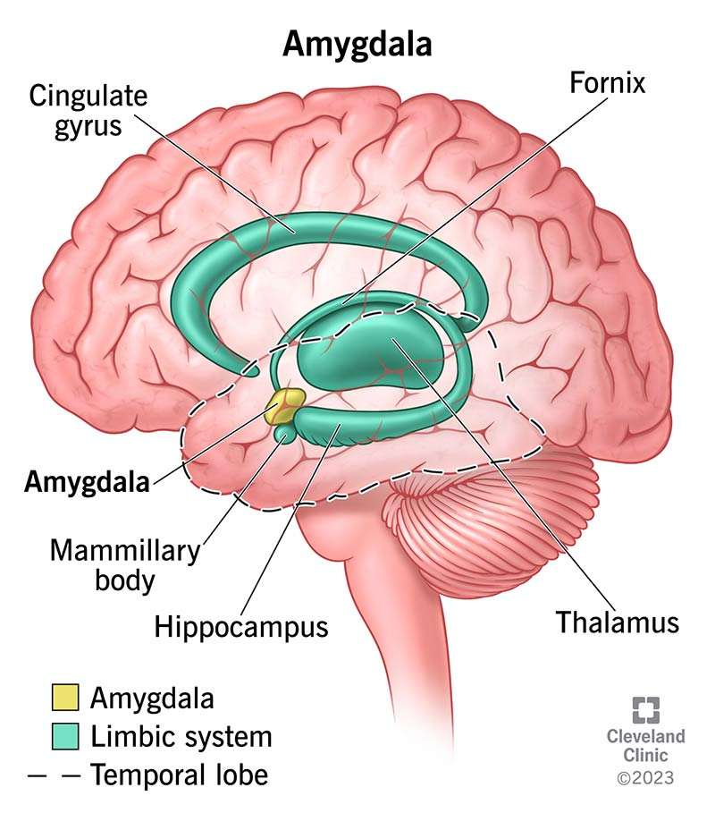
Brain and body sources of anxiety…
Your amygdala is a small, almond-shaped structure inside of your brain. It’s part of a larger network in your brain called the limbic system. When it comes to your survival, your amygdala and limbic system are extremely important.
These are parts of your brain that automatically detect danger.
They also play a role in behavior, emotional control and learning.

Slide 12
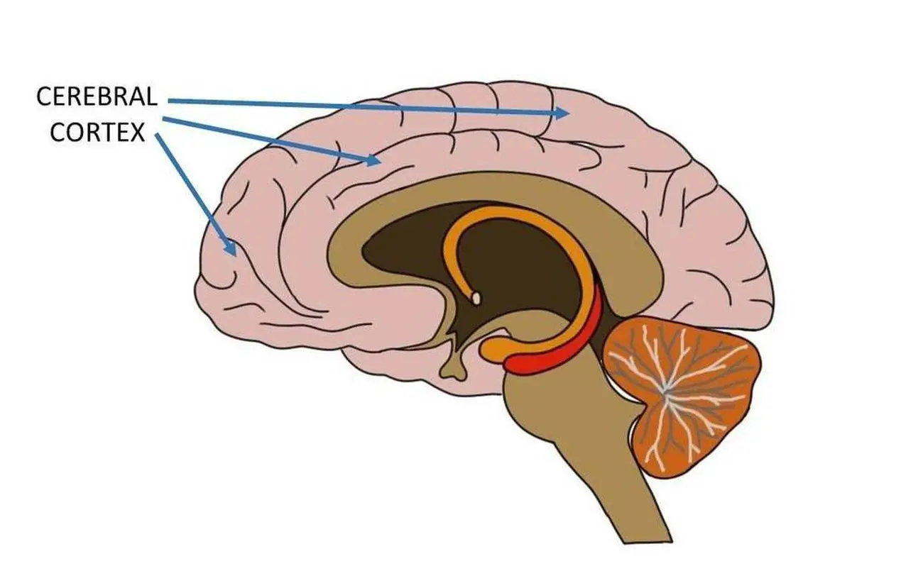
Brain and body sources of anxiety…
Neocortex: The newer portion of the cerebral cortex that serves as the center of higher mental functions for humans.
These are the parts of your brain involved in thinking.
The cells in the neocortex are arranged in six layers, within which
different regions permit vision, hearing, touch, the sense of balance,
movement, emotional responses and every other feat of
cognition and thinking

Slide 13
The creation and the continuation of anxiety involve both the amygdala and the cortical pathways
Neocortex: The newer portion of the cerebral cortex that serves as the center of higher mental functions for humans.
These are the parts of your brain involved in thinking.
The cells in the neocortex are arranged in six layers, within which
different regions permit vision, hearing, touch, the sense of balance,
movement, emotional responses and every other feat of
cognition and thinking

Slide 14
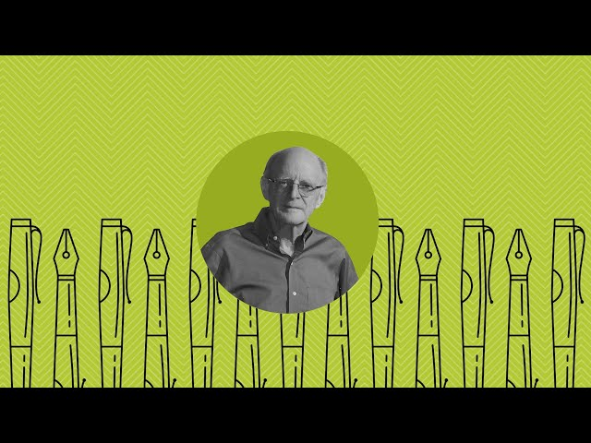
Psycho-Educational Resources for Trauma & Toxic Stress https://www.ted.com/talks/nadine_burke_harris_how_childhood_trauma_affects_health_across_a_lifetime https://youtu.be/XsHIV9PxAV4

Slide 15
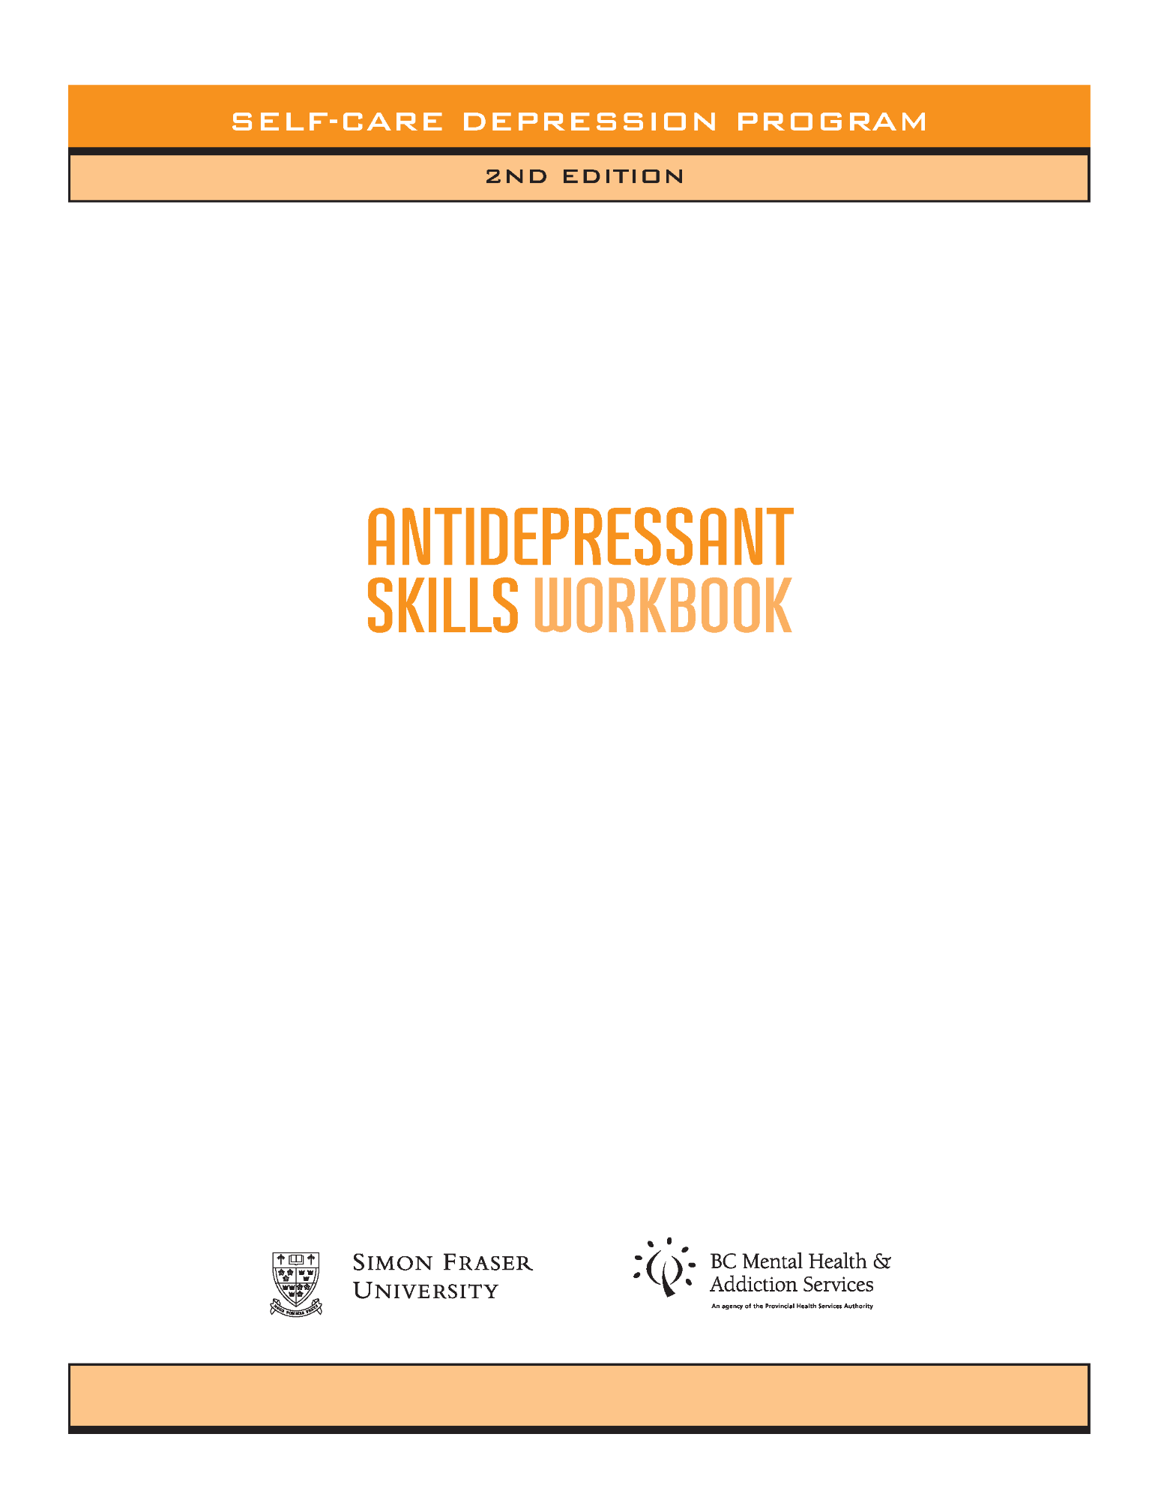
Guided Self-Help for Depression https://psychhealthandsafety.org/asw/

Slide 16
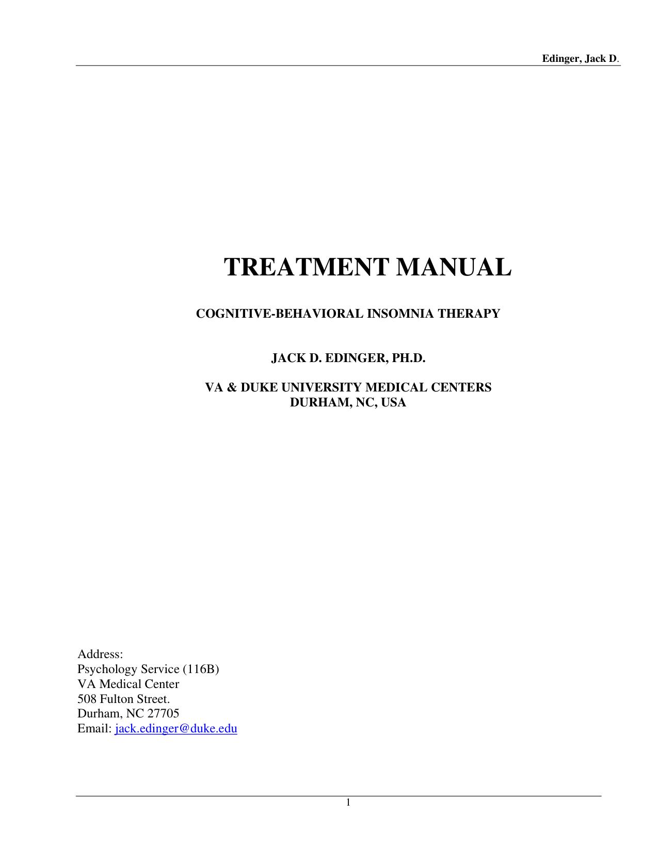
Brief Intervention for Sleep Disturbance Edinger JD, Sampson WS. A primary care “friendly” cognitive behavioral insomnia therapy. SLEEP 2003;2:177-182.

Slide 17
Brief Intervention for PTSD B.R.E.A.T.H 3 Session EBP Contact Bob at Bob.Phillips@ENMU.edu
B.R.E.A.T.H.E.
(Brief Relaxation, Education and Trauma HEaling):
A Brief Intervention for Persons with PTSD and Co-Occurring Serious Mental Health Conditions
Treatment Program Manual and Client Handouts
(Version 3)

Slide 18
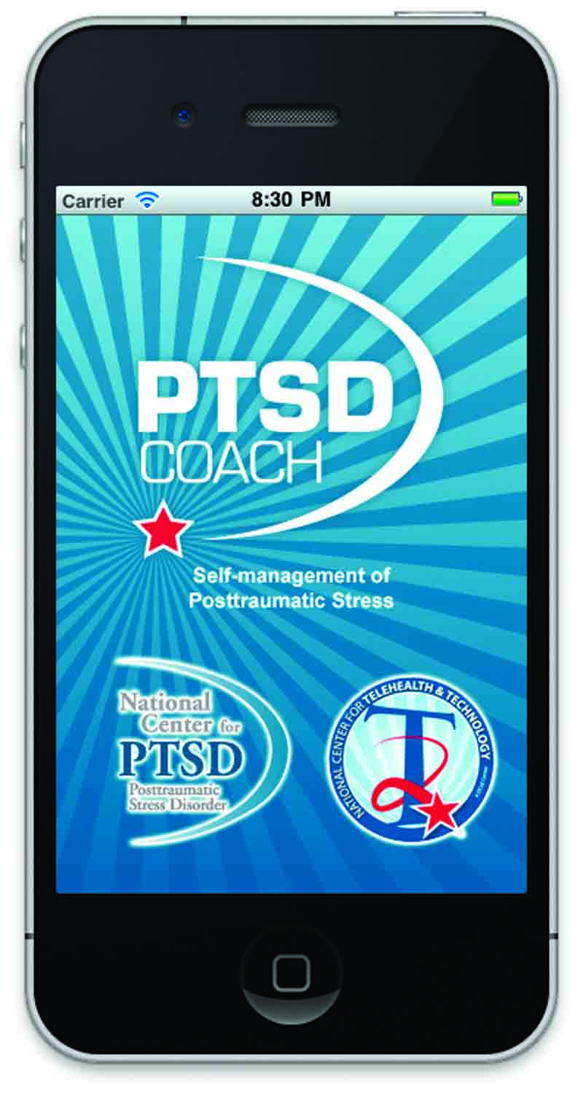
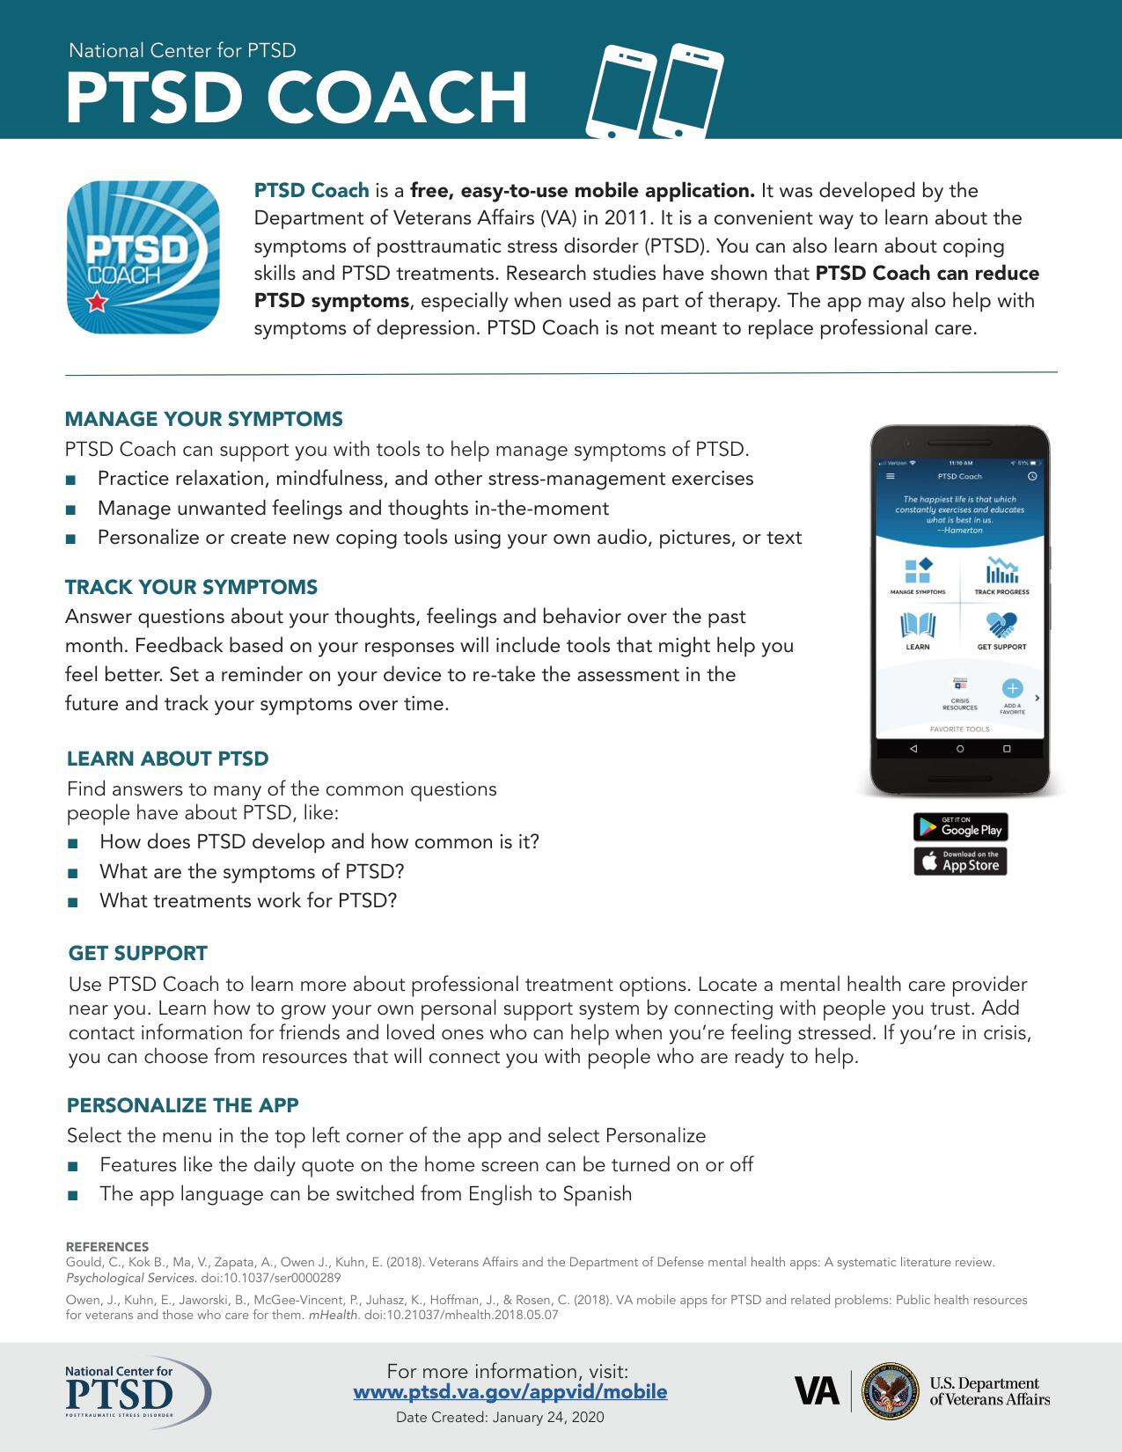
PTSD COACH Your One-Stop Shop PTSD COACH ONLINE https://www.ptsd.va.gov/apps/ptsdcoachonline/default.htm

Slide 19
THANK YOU KINDLY
FEEL FREE TO CONTACT ME AT ANY TIME
BOB PHILLIPS, D.BH
Bob.Phillips@enmu.edu
https://bobphillips.academia.edu

