Slide 1
Legalized Cannabis, ‘A Brave New World’ or ‘Cannatopia v The ‘Rabbit Hole…’v worm hole… v …
Michael A. Fraga, Psy.D., MSCP
Neuropsychology
Psychopharmacology
Neurodegenerative Disease
Forensics

Slide 2
From Where…
The medicinal properties of the cannabis plant have been known for millennia. As far back as 2800 BC, cannabis was used to treat a vast array of health problems and was listed in Emperor Shen Nung's pharmacopoeia.
BC Hindu legend holds that Shiva was given the title ‘The Lord of Bhang’ because the cannabis plant was his favorite food.
129-200 AD
Galen used cannabis for its therapeutic properties and mood enhancement.

Slide 3
Where?
1600’s: In the early 1600s, the British government encouraged colonial farmers to produce hemp, a form of cannabis with low levels of the psychoactive ingredient THC. The extremely hardy, fast-growing plant was primarily used for the production of rope, sails, clothing and paper, a fiber critical to the British and Spanish empires.
1619, the Virginia Assembly passed a law that flat-out required farmers to grow it.
1841: William Brooke O’Shaughnessy introduced cannabis to Western medicine after living in India. He wrote of many therapeutic uses of cannabis, including a case where cannabis stopped convulsions in a child ( fast forward, the 1st recognized MEDICAl use of cannabis… EPILEPSY).
After the Mexican Revolution of 1910, a wave of Mexican immigrants poured into the southwestern U.S. and helped popularize the recreational use of the drug. Cannabis in Spanish was referred to as “marihuana” or "mariguana" ("marijuana" is the Anglicized bastardization).

Slide 4
‘Demon Weed’, cont.;
As the drug grew more popular, it was negatively associated with Mexican immigrants. Anti-drug campaigners began to warn against the encroaching "Marijuana Menace," describing the terrible crimes attributed to the drug and the Mexicans who used it.
1911: "Within the last year we in California have been getting a large influx of Hindoos and they have in turn started quite a demand for cannabis indica," wrote Finger in a 1911 letter (page 18). "They are a very undesirable lot and the habit is growing in California very fast; the fear is now that it is not being confined to the Hindoos alone but that they are initiating our whites into this habit.“
"It was only referred to as marijuana "because anti-cannabis factions wanted to underscore the drug's 'Mexican-ness,' meant to play off of anti-immigrant sentiments," noted Matt Thompson from NPR's Code Switch blog. Rumors quickly spread of Mexicans distributing this "demon weed," or "locoweed," to unsuspecting American schoolchildren. In port cities along the Gulf Coast, the drug also became associated with West Indian immigrants, a connection broadly extended to African-Americans, jazz musicians, prostitutes and lower-class whites.

Slide 5
Alice!, Where are we (ed)?!?!?
1913: California (of all places) passed the first state cannabis prohibition law. The effort was sponsored by the state Board of Pharmacy as part of a larger anti-narcotics campaign (even though there was at the time still little public concern about cannabis). Proposed by Henry Finger, a powerful member of the board, the law was intended to supposedly prevent the spread of the drug's use by “Hindoo” immigrants.
1931: Harry J. Anslinger, the first commissioner of the newly created Federal Bureau of Narcotics, insisted that marijuana led to “insanity, criminality, and death." By 1931, 29 states had outlawed it.
1936: The film Reefer Madness was released, demonizing cannabis as a highly addictive drug that caused mental disorder and violence (as told by a concerned school principal, Joseph Forte,to a PTA meeting.

Slide 6
Where???
Originally titled "Tell Your Children," the film centers on a series of hyperbolic events that ensue when innocent high school students are lured into trying marijuana — from a hit-and-run accident to manslaughter, suicide, attempted rape, hallucinations and a rapid descent into madness. (Alice!!!! Are we there yet?!?!?)
1937: Marijuana Tax Act / The uses of cannabis (“evil weed”) for medicinal and recreational purposes were effectively taxed out of existence in the USA by the Marijuana Tax Act. 1st time the drug was REGULATED and TAXED!!! Read, criminalized; restricting it to individuals who paid an excise tax for certain authorized medical and industrial uses. (Oh, Oh! We have a problem here Alice!!!)

Slide 7
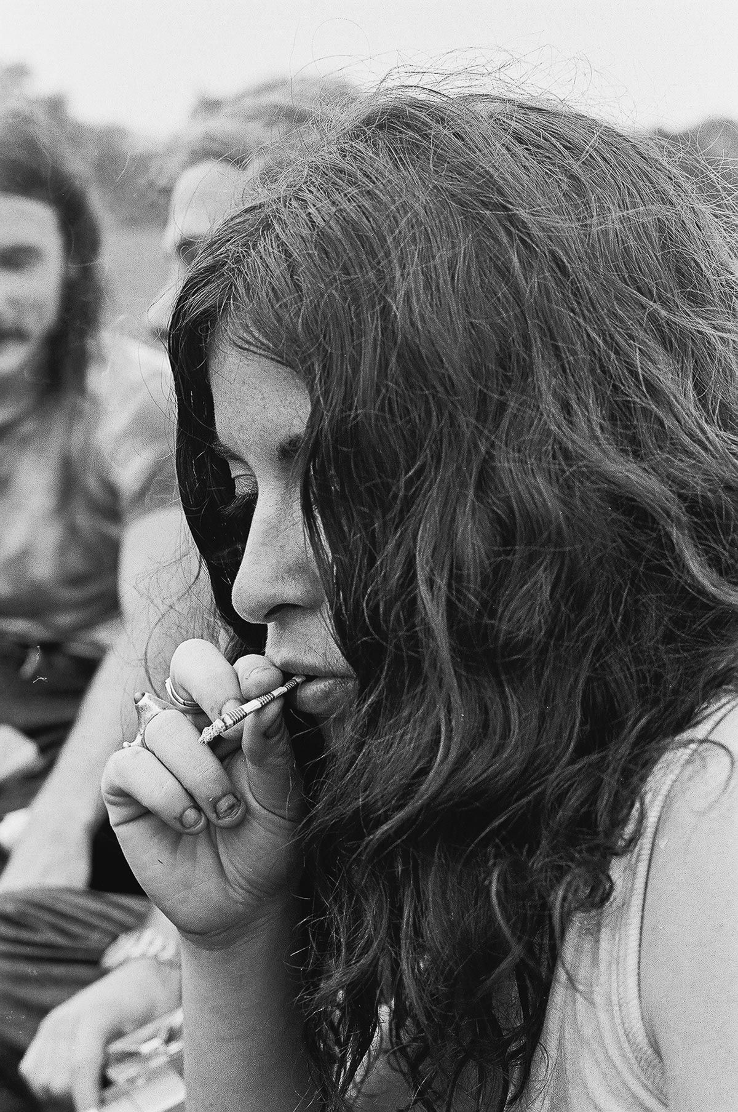

Slide 8
Adoption of marijuana by both young hippies in the anti-war movement and the WHITE MIDDLE CLASS (oh maybe not…)
1970: Controlled Substances Act
US introduced the Controlled Substance Act that lists cannabis as having ‘no accepted medical use and a high potential for abuse’. Including cannabis in this category was more a reflection of "Nixon’s animus toward the counterculture with which he associated marijuana than scientific, medical, or legal opinion." (Martin, Bowling Green State University)
Congress in 1970 passed the Controlled Substances Act. It created various legal categories, or schedules, for different types of drugs, depending on their perceived public threat. Cannabis was placed alongside heroin and LSD into Schedule 1, the most restrictive category.

Slide 9
What?!?!?!?!?!

Slide 10
I'm lost…
1972: Shafer Commission, an investigative committee appointed by Nixon to study drug abuse in America, went on to recommend that possession of small amounts of marijuana be decriminalized. In 1972, a year after Nixon declared his "war on drugs," the commission presented its findings to Congress in a report titled:“ Marihuana, A Signal of Misunderstanding".
Reports commissioned by Presidents John Kennedy and Lyndon Johnson found that marijuana use did not induce violence or lead to use of heavier drugs. California legalized medical cannabis by introducing the Compassionate Use Act.
It noted that most marijuana users were not dangerous at all, but rather more "timid, drowsy and passive." It concluded that cannabis did not pose any widespread danger to society.

Slide 11
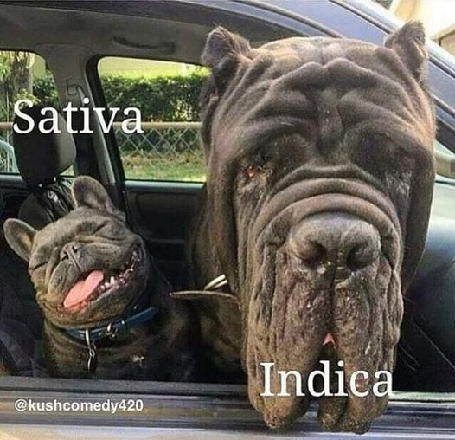
I’m not sure…
Indica must have been more prevalent then…

Slide 12
GPS Time…
A movement spearheaded by the newly established National Organization for the Reform of Marijuana Laws (NORML) resulted in Oregon passing the first decriminalization statute in 1973. Over the next five years, 10 other states followed suit, from California to (astoundingly) Mississippi.
1986: Anti-Drug Abuse Act
President Reagan in 1986 signed the Anti-Drug Abuse Act, instituting mandatory sentences for drug-related crimes. The legislation had actually been championed by Democrats, who saw a political opportunity to outdo Republicans by "getting tough on drugs." (A logical dynamic to me… maybe.)The shift was in part a response to the nation's shock over the death of Celtics star draft pick Len Bias from a cocaine overdose. (“My cousin from Boston”)

Slide 13
Mandatory Sentencing… the “Fix”
Penalties were based on the amount of the drug involved. Under the law, possession of 100 marijuana plants received the same penalty as possession of 100 grams of heroin.
A later amendment established a "three strikes and you're out" policy, requiring life sentences for repeat drug offenders.
Drug-related arrests soared, spurring a massive increase in the state and federal prison populations. At the time of the law's enactment in1986, there were roughly 400,000 inmates.

Slide 14
Does anybody have a map here?!?
2015: By 2015, the population had nearly quadrupled, to a peak of almost 1.5 million, giving the U.S. the dubious distinction as the largest jailer in the world. (Weren’t we touting ourselves as the most humane ‘free nation’ on the planet? Just saying here… memory being what it is after 60 years of age…)
Marijuana arrests factored heavily in this increase, accounting for more than half of all drug arrests, mostly for possession. African-Americans (contemporary Hindoos…) were, and still continue to be, arrested at dramatically higher rates than whites, despite similar rates of usage (remember they were earlier defined as the white middle class. TRANSLATION, the VOTING section of America).

Slide 15
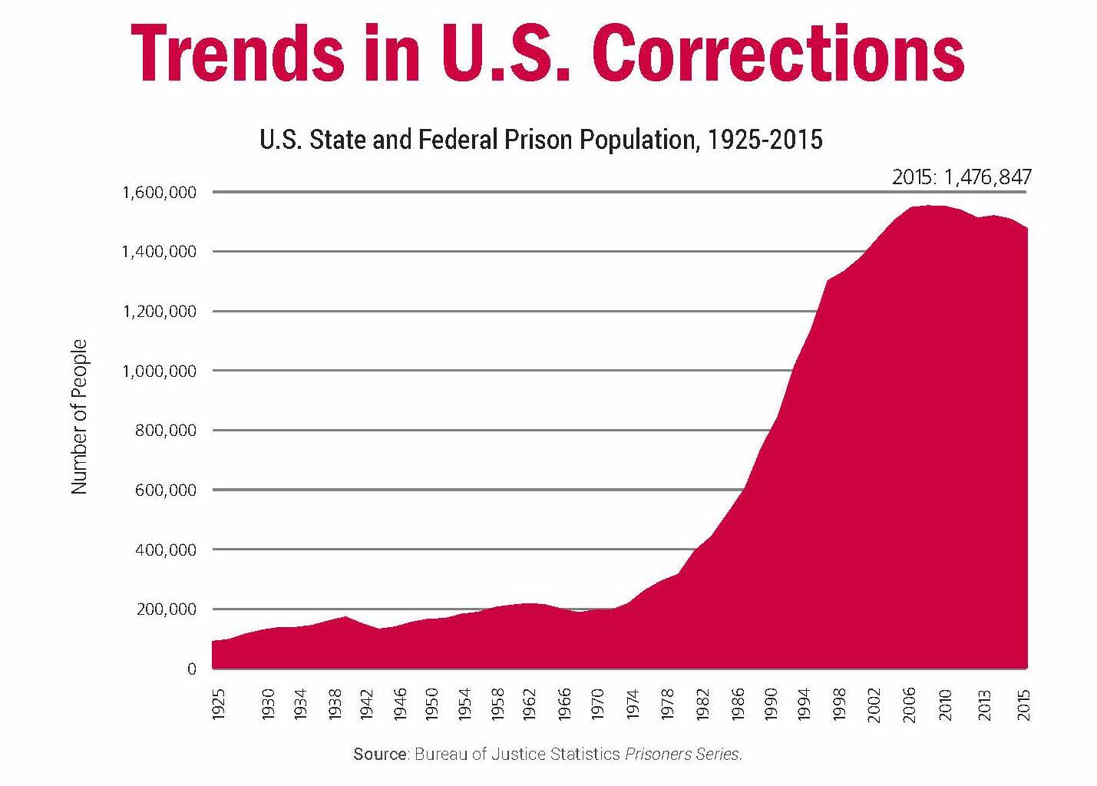

Slide 16
Fast Forward…
2012: CBD shown to alleviate schizophrenia symptoms in patients comparable to a conventional antipsychotic drug.
Proposition 215: Via a solid majority of voters, California bypassed federal law and became the first state to legalize the sale and medical use of cannabis for patients with AIDS, cancer and other serious and painful diseases.

Slide 17
And…
2016: Australia legalized medical cannabis and its cultivation for medical purposes.
Washington and Colorado became the first states to approve legal recreational use in 2012. New York legalized marijuana recreationally in 2021. At least 23 U.S. states have already legalized recreational marijuana for adults.
Amendment 64 (apparently a popular number), regulates and taxes marijuana and allows adults to possess up to an ounce of the drug.
2017: CBD demonstrated to reduce seizures in childhood epilepsy in a placebo-controlled trial. (Didn’t we ‘know’ this is 1841?!) ABN: 15 211 513 464 CRICOS Number: 00026A TEQSA: PRV12057

Slide 18
Parallel Process or?
For centuries Europeans consumed large quantities of beer, wine and hard liquor. When they migrated to the Americas in the 1600’s they brought along their hearty drinking habits.
As such, Americans have been heavy users of alcohol for over 300 years.
At the time, New Englanders, the ‘Puritans’ called alcohol the ‘Good Creature of God’, a holy substance to be consumed proudly, but ‘cautiously.’
People of all ages consumed alcohol, including ‘toddlers’ who /finished off the heavily sugared portion at the bottom of a parent’s mug of rum toddy.’ W. J. Rorabaugh is p67.0.220.218

Slide 19
Use or Abuse? Consumption Trends…
1950’s – 1970’s consumption rose steadily. The poor drank, the affluent drank the most…
Doctors and lawyers were reported to be the ‘heartiest toppers.’
Young people consumed more than the old, whites drank more than blacks.
Alcohol use appeared to peak between the ages of 25-35yo especially for single males.
Increased numbers of ‘baby boomers’ in the ‘prime drinking bracket’ accounted for the bulk of same (1960-70’s).
More women began to drink and drank more when they did.

Slide 21
Impacts cont.
Similar to history’s enforcement of marijuana prohibition, alcohol prohibition famously clogged our criminal justice system with alcohol related cases, many for relatively minor offenses. The justice system was so overwhelmed that a large backlog of cases led to the emergence of the “plea bargain,” where defendants would plead guilty to a lesser offense in order for the courts to clear throngs of cases.
Historically, this practice was commonplace in our criminal justice system, driven largely by non-violent drug offenses and more than 660,000 marijuana arrests per year. It had gotten so pervasive that today only 3% of federal drug cases actually go to trial, with the rest being settled through plea bargains rather than a real determination of guilt or innocence. Krane, K. 2019.

Slide 22
Trends cont.
Over the course of the 80’s and 90’s teenage consumption became a major issue.
More alarming was the evidence of severe alcohol related problems, i.e. physical addiction among older adolescents who had only been consuming alcohol for a few years.
It has been proffered that the ‘acceptance of alcohol has always ‘depended upon the social context surrounding its’ use.’ (sound familiar?)
The general response from the consuming American public of the mention of alcohol has been noted as ‘an uneasy laugh that is symbolic of both the joy and sorrow in American culture.’ W. J. Rorabaugh, 67.0.220.218
TODAY – alcohol consumption is viewed as an integral component of life and a measure of an individual’s ability to be responsible in their consumption to themselves and others… or not. OAH Magazine of History Vol. 6, No. 2, Drug Use in History (Fall, 1991), pp. 17-19

Slide 23
Parallel Process? Social and/or biological…
The consumption of mind altering substances and practices is noted in the human record from the earliest recordings of such practices.
Children’s whirling dervish type behaviors, breath holding, the utilization of multiple herbs, abstinence practices (food, social interactions, etc.) and the deliberate ingestion/exposure to toxic botanical and biological agents (datura root, desert frog toxins, various gases, sweat lodges, etc.).
The desire to alter consciousness has been argued to be a core aspect of the human condition and is often encapsulated in religious or consciousness raising practices promoted to foster ‘enlightenment.’

Slide 24
Cannabis, Brave New World or?
The introduction of cannabis into the American culture has in many ways paralleled the historical process of alcohol.
Initially promoted for its medicinal healing properties, elevated to social rejection as a result of its’ use/abuse’ characteristics, reconceptualized as having medical value and finally elevated to socially ‘acceptable’ w/responsible consumption practices.
The path of novelty to vilification, to one of social/medical acceptance has been driven in the not so ‘background’, by financial profiteering and political aspirations. Fraga, M. A; Politics of Addiction, NMAEN 2021
Drug issues are highly political. The drugs trade is the second most highly lucrative industry in the world, following the arms trade but preceding oil. Criminology Australia, 1995, p.14.

Slide 25
Or ?
Which substances are defined as drugs, how their supply and use is regulated, how society responds to people who use drugs – all of these are political issues. Fraga, M.A., 2021
The fact that the two drugs that cause the most harm and damage in the world today – tobacco and alcohol – are both legal in most countries, powerfully illustrates this point. The status of various drugs has been greatly influenced by political and economic interests. Copyright © Dulwich Centre Publications 1997
According to BofA Securities, cannabis sales in the U.S. increased 40% in 2021 to $25 billion. While that's not as much of an increase as the 67% jump 2020 saw, it still easily surpassed the $18 Billion in sales from 2020.

Slide 26
Revenues drives regulations…
Legal marijuana sales in the U.S. expected to hit $33 billion by the end of 2022, according to a new study by MJBiz, a leading B2B cannabis industry resource. That's a 32% increase over 2021's total of $25 billion. This increase being driven largely by the opening of new adult markets. Apr 11, 2023.
Ten years ago Colorado became the first state in the U.S. to fully legalize the recreational use of cannabis. Many other states followed, and several others already had sufficiently lax medical marijuana legislation. Now an estimated 60+% of American adults can legally buy cannabis.

Slide 27
$$$ cont.
One motivation for legalization is the economic benefits that can come from the regulated commercial availability of marijuana. Increased tax revenues, job growth, and investment opportunities all are powerful incentives to push for legalization.
It is estimated that the federal government alone forfeited $11 billion in alcohol related taxes during prohibition years, a number the government could hardly afford during a period of runaway unemployment and economic pain.

Slide 28
$$$ v Social Impacts cont.
Today, unemployment claims which reached record highs, post the COVID-19 crisis, have only minimally declined (wherein 36 million Americans filed for unemployment benefits during the Covid-19 crisis, a spike unmatched at any time since the country began tracking such figures shortly after WWII.)
Americans needed jobs in record numbers and governments needed new sources of tax revenue. Hence, Continuing the country’s 70+ year experiment of cannabis prohibition, when two thirds of Americans support its repeal, was simply ‘economically reckless’.
According to a recent study by New Frontier Data, national legalization in the United States could result in $128.8 billion in tax revenue, and an estimated 1.6 million new jobs.
Again the emphasis not on harm to the individual, rather benefit to the ‘state’.

Slide 29
Economic Benefits v Social Impacts
Musicians, actors and sports stars have quickly jumped into the market with their own brands of weed, hoping to lure people who want to get high with a high-end product.
Some of these—Willie Nelson, Snoop Dogg, Seth Rogen—are unsurprising. Others are less likely weedpreneurs, including Bella Thorne, Jaleel White—the actor who played Steve Urkel in Family Matters—and former NBA star Al Harrington. The newly legal industry was predicted to be a multibillion dollar business and a big tax revenue win for the states. Luscombe, Belinda, Time Magazine, June 21, 2022

Slide 30
Social Impacts…
Alcohol prohibition had unintended consequence that have become the stuff of American storytelling legend: the rise of organized crime which took over the trade (alcohol sales/distribution) in the absence of regulated and licensed businesses.
FTR, prohibiting alcohol never stopped Americans from seeking it out and consuming it. Much like today where millions of Americans enjoy cannabis even in states where it remains illegal to do so.
Over the decades of cannabis prohibition, control of the marijuana trade led to a rise in gang violence in the United States, as well as countless civilian deaths and terror south of the border in the decades long Mexican drug wars. It is estimated that 30% of Mexican drug cartel revenue was derived from illicit cannabis trafficking in 2020.

Slide 31
Impacts cont.
It was alleged that this aspect would largely disappear with legalization, much like ending alcohol prohibition dried up a substantial portion of the gangster’s profits. It did reduce profits, and unfortunately fostered diversification. Krane, K; Forbes, 2019.
Contrary to some government and media estimates, Mexican DTOs’ annual gross revenues (2021-2022) from illegally exporting marijuana and selling it to wholesalers in the United States were likely less than $2 billion; the study authors’ preferred estimate is $1.5 billion. (Beau Kilmer, Jonathan P. Caulkins, Brittany M. Bond, Peter Reuter)
California accounts for about 14 percent of U.S. marijuana consumption, and domestic production is already prominent in California. Thus, if marijuana legalization in California affects only revenues from supplying marijuana to California, Mexican DTO drug export revenue losses would be very small, perhaps 2–4 percent.

Slide 32
Hmmm…
In 2013, US authorities seized roughly 1.3 million kilograms of weed at the border, according to the DEA. By 2019, that had fallen to nearly 249,000 kilograms.
In the years since, "Mexican marijuana has largely been supplanted by domestic-produced marijuana" in US markets, according to the DEA's 2020 National Drug Threat Assessment.
Over the past five years, marijuana prices in Mexico have decreased by more than half, prompting criminal groups to produce more dangerous drugs, like fentanyl, to maintain profits and pushing independent farmers to harvest plants like opium to sustain themselves.

Slide 33
Net Outcomes… XXX
"This is a business that belongs here, to Sinaloa," a Sinaloa Cartel operative who works as a regional manager for marijuana operations in Culiacán told Insider. "We lost a share of the business, but in no time we will take it back by producing the best weed in the world.“
As more and more US states legalize marijuana for recreational use, Mexico's biggest drug cartel is trying to corner the legal weed market in Mexico, even if the drug itself is not yet legal in Mexico.
"This is by far not the final product. We are buying seeds from all over the world to create our own strain, to produce top-notch Sinaloa weed and to develop a strong brand even better than the gringos," the producer said, referring to growers in the US.

Slide 34
Outcomes cont.
Marijuana legalization has often been seen as a political third rail in American politics. ‘Conventional political wisdom’ has kept even supporters of legalization from speaking out in fear of being branded as “soft on crime.” But American attitudes towards legalization have shifted dramatically over the past decade, with Gallup finding support for legalization having risen 30% between 2005 and 2018. 66% of Americans are currently in favor of legal cannabis. When legalization has been put before voters through state ballot initiatives, it has passed 10 out of 11 times.

Slide 35
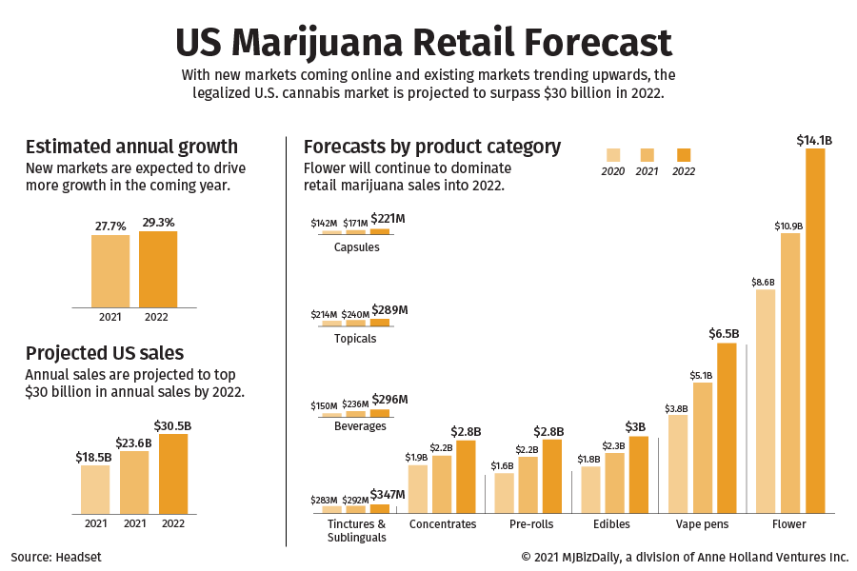

Slide 36
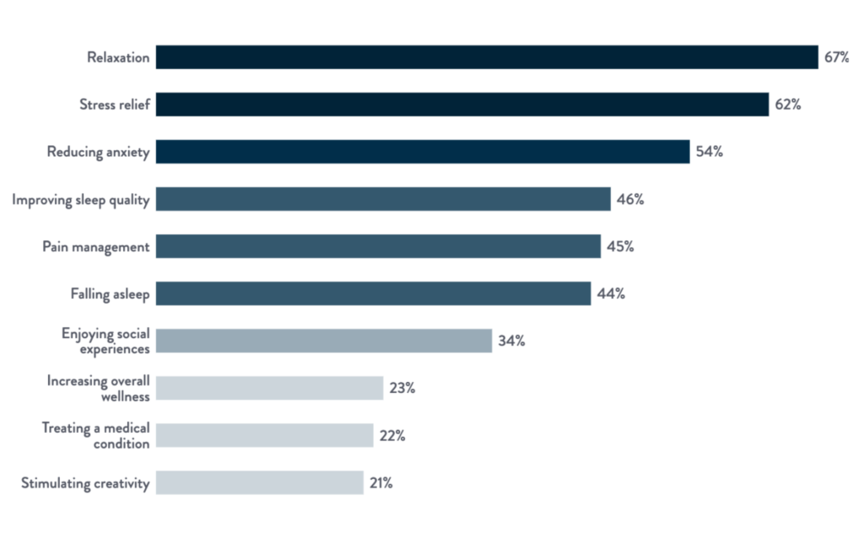

Slide 37
Consumer Demographics.
In 2012, 11.6% of US adults had used cannabis in the past year, while 7.1% had done so in the previous month.
By 2021, this had increased to 16.9% of US adults using cannabis in the past year and 11.7% in the previous month, increasing by around 46% and 65% respectively. Substance Abuse and Mental Health Services Administration. (2020). Key Substance Use and Mental Health Indicators in the United States: Results from the 2019 National Survey on Drug Use and Health, Available at: https://www.samhsa.gov/data/.
Statistics paint an interesting picture of what’s happened between 2011 and 2020.
8th graders 11.4%
10th graders 28%
12th graders 35.2%

Slide 38
Demographics cont.
Age breakdown for cannabis users (based on the New Frontier data) shows a clear peak between 25 and 44, with less use in other age brackets. Specifically, around 4% of users are 18 to 20, 7% are 21 to 24, 26% are between 25 and 34 and 22% are between 35 and 44 (25-44yo/48%). For older people, 32% are between 45 and 64. The remaining 10% are 65 or older.
Based on New Frontier’s survey of 4,601 cannabis consumers in September 2020, there is a roughly even split of cannabis use by gender, with 51% male and 49% female consumers. Traditionally, there was a gender imbalance in which men used more cannabis than women overall, and in some other data this does appear to persist.

Slide 39
Cont.
72% of cannabis consumers are white, while in the overall population white (not including dual heritage, Hispanic or Latino) people make up 60.1% of the population. Black Americans account for 11% of cannabis users, while making up 13.4% of the population overall. Hispanic or Latino people make up 11% of cannabis users but 18.5% of the US population (31.9% combined). Asian people make up 3% of cannabis users and 5.9% of the population. Other races, including natives of America, Alaska, Hawaii and Pacific Islands, account for 3% of cannabis users and 1.5% of the population (39.4% of the pop overall).
People of two or more races are the most likely to use cannabis, with 30.5% of people in this group using pot, compared to 20.4% for American or Alaskan Natives, 20% for Black or African Americans and 18.9% for non-Hispanic white people.

Slide 40
Demographics cont./income/education levels.
Cannabis users tend to cluster around lower income levels, with people making between $25k and $50k per year accounting for a quarter of all users. People earning under $25k account for 19%, and those earning between $50k and $75k are another 19%. Around 12% earn from $75k to $100k and another 12% earn from $100k to $150k. Higher earners are much rarer, with 7% earning between $150k and $200k and 5% earning more than this.
People who’ve completed some college account for the majority of cannabis users, at 36% of users. The next most represented group is people with a bachelor’s degree, who make up 28% of users. Those with graduate degrees account for 18% of cannabis users, and finally those who finished education with high school are the remaining 16%.
84% of users have a higher education.

Slide 41
Cont.
This clearly shows the impact of legalization, and the breakdown in terms of the laws of the individuals’ home states underlines the key point. For tokers in legal states, 67% use dispensaries, making it the most popular source by far (with just 16% using dealers), whereas in states with a completely illicit supply, 52% get weed from friends and 36% use a dealer.
A majority of this growth comes from recreational sales. Especially so as legalization comes ‘of age’ in more states, defined medical usage has declined. In 2019, the medical market was at $5.9 billion and the recreational market was at $7.4 billion, while by 2025 it’s projected to be $15.5 billion medical and $27.4 billion for recreational. The compound annual growth rates are 11% for legal medical sales and 20% for legal adult use sales, working out to 16% overall for legal sales.

Slide 42
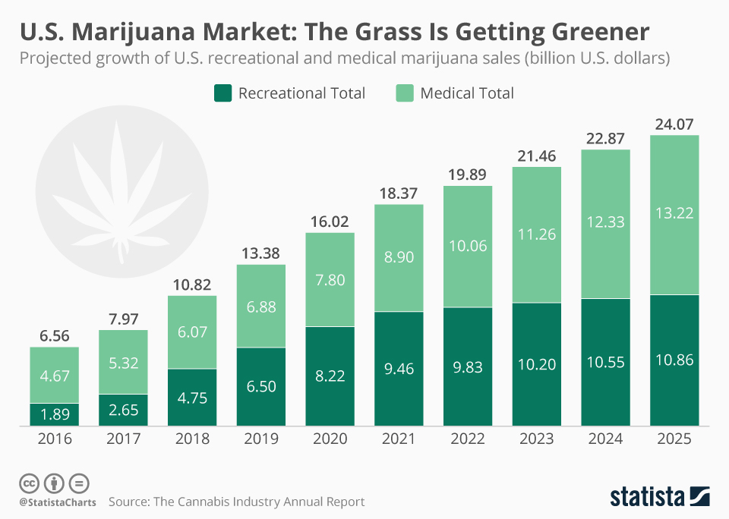

Slide 43
Perceptions and future process…
Despite some disagreement on the legal and moral issues surrounding cannabis, people generally don’t see it as especially dangerous, particularly in comparison to things like cigarettes or alcohol. The data (from a Politico/Harvard P.H. Chan School of Public Health survey) shows that 81% say that cigarettes are very harmful, 51% say alcohol is, 47% say e-cigarettes are and just 26% say the same about cannabis.
There isn’t much variation based on political viewpoint, either, with the only major difference being that Republicans are less likely than Democrats to say alcohol is very harmful, although 46% still say that it is.
Overall, 30% of cannabis users said they prefer alcohol, 26% like both equally and 44% prefer cannabis.

Slide 44
A Call to Action…
As the data across various surveys detailing usage, ethnicity, SES and political utility and profit indicate, the legalization of cannabis use on a federal level is inevitable.
What is missing from the plethora of the cannabis discourse is the impact on the individual, developmentally, socially and functionally.
As such, it behooves the Addiction Community to develop a stronger voice in the growing movement towards the blanket adoption of cannabis.
The long-term effects/consequences are notably lacking expression, validation, and accountability in the developing rules and regulations concerning the global validation of the legalization of cannabis.

Slide 45
Call to Action cont.
Unlike alcohol, cannabis exposure/use clearly evidences an earlier onset w/negative impacts on the neurobiological development of adolescent consumers.
New Mexico touts its’ programs as being cutting edge. However, its’ stated primary concerns are on supply side shortages and the approval of legislation that will negatively impact the small ‘mom and pop’ producers in favor of the corporate behemoths. (Read TAXES!!!)
What is painfully lacking in plain sight or verbiage, are concerns for the consumer, beyond supply and demand. The social, psychological and medical impacts of this process are nowhere in sight.

Slide 46
Terminology ‘Smoke Screens…
Medical and adult use are legal categories, not different kinds of cannabis plants or products.
Adult-use cannabis is often consumed for its enjoyable mind-altering effects.
Most adult-use cannabis products contain a chemical called tetrahydrocannabinol (THC). THC has mood-altering effects and can cause impaired thinking and body coordination. THC has important medical uses. But people also consume it for the “high” feeling it gives them.
To make matters somewhat confusing, many medical patients buy their cannabis at adult-use dispensaries. So not every customer at a recreational cannabis store is using the substance for non-medical reasons.

Slide 47
‘Smoke Screens’ cont.
While medical and recreational marijuana costs are typically the same for quality and type, they can be drastically different when it comes to taxes. Recreational marijuana consumers in some states can end up paying sales tax, local tax, and excise tax in addition to the price of their product.
It all goes back to the intent of use. Recreational cannabis is mainly used for enjoyment purposes, while medicinal cannabis is a legitimate form of treating health issues. Medical cannabis manages symptoms from various conditions such as chronic pain, neuropathic pain, anxiety, insomnia, and epilepsy. More severe ailments are also treated, such as cancer-related pain and chemotherapy-induced side effects such as vomiting, nausea, poor appetite, sleeping difficulty, and depression.

Slide 48
‘Screens’ cont.
Medical – less retail markup: medical cannabis isn’t subject to the volatile price fluctuations that arise from uncertain market conditions, supply, and purchase price from producers.
Medical cannabis patients enjoy more freedom and flexibility regarding where they can responsibly consume their medication.
Recreational users may only carry up to 30 grams on their person at any given moment. However, medical cannabis patients are permitted to carry 150 grams.

Slide 49
Negative Impacts…
Today's marijuana has three times the concentration of THC compared to 25 years ago.
Marijuana is linked to problems in school. Marijuana dulls your attention, memory, and learning skills.
Students who use marijuana are more likely not to finish high school or get a college degree. Marijuana also affects timing, movement, and coordination, which can harm athletic performance.
n addition to addiction, marijuana use is linked with a higher risk for schizophrenia, depression, and anxiety. It’s not clear if marijuana use actually causes these conditions, but research shows a connection. The amount of drug used, the age at first use, and a person’s genes influence this relationship.

Slide 50
No rabbits in here…
Short-term effects:
Long-term/repeated use:
learning, attention, and memory problems
distorted perception (sights, sounds, time, touch)
poor coordination
increased heart rate
anxiety, paranoia
psychosis (not common)Short-term effects:
risk of marijuana addiction
long-term learning and memory problems if heavy use begins during youth
risk for chronic cough, bronchitis
risk of schizophrenia in some people with higher genetic risk
in rare cases, risk of recurrent episodes of severe nausea and vomiting
aging confounds…

Slide 51
Say What?!?
Some people think that vaping is a safer way to use marijuana because you're not inhaling smoke. But you're still inhaling various chemicals when using a vaporizer. A study of some vaporizer products found the vapor contains toxic chemicals and possibly toxic metal particles from the device itself. Hess CA, Olmedo P, Navas-Acien A, Goessler W, Cohen JE, Rule AM. E-cigarettes as a source of toxic and potentially carcinogenic metals. Environ Res. 2017;152:221-225. doi:10.1016/j.envres.2016.09.026
K2 or Spice refers to plant materials that have been coated with chemicals similar to the chemicals found in marijuana. Some people mistakenly think K2/Spice and marijuana are the same thing, but they're not. Sellers advertise K2/Spice as both a "safe" and "legal" substitute for marijuana. Neither is true. Although labels on K2/Spice products often say that they contain "natural" material from plants, their active ingredients are made in labs. These chemicals act on the same brain areas as THC. However, some chemicals in K2/Spice may produce much more powerful, unpleasant, and unpredictable effects, such as extreme anxiety, paranoia, and hallucinations.

Slide 52
Cannabis consumption is for adults only. Many things and activities are suitable for young people, but others absolutely are not. Children do not drive cars, enter into contracts or marry, and they must not use drugs.
The responsible cannabis user does not operate a motor vehicle or other dangerous machinery impaired by cannabis. Although cannabis is said by most experts to be safer than alcohol and many prescription drugs with motorists, public safety demands that impaired drivers be taken off the road and that objective measures of impairment be developed and used, rather than chemical testing.
The responsible cannabis user will carefully consider his/her setting and regulate use accordingly. The responsible cannabis consumer will be vigilant as to conditions -- time, place, mood, etc. -- and does not hesitate to say "no" when those conditions are not conducive to a safe, pleasant and/or productive experience.
Use of cannabis, to the extent that it impairs health, personal development or achievement, is abuse and should be resisted by responsible cannabis users. Abuse means harm. Some cannabis use is harmful; most is not. That which is harmful should be discouraged; that which is not need not be.
The responsible cannabis user does not violate the rights of others, observes accepted standards of courtesy and public propriety, and respects the preferences of those who wish to avoid cannabis entirely. Regardless of the legal status of cannabis, responsible users will adhere to emerging tobacco smoking protocols in public and private places.

Slide 53
Contact Information:
Michael A. Fraga, Psy.D., MSCP
Integrated Health Management, Clinical and Consulting Services
nyrodoc@gmail.com
707.494.1303

