Slide 1
The Fentanyl Crisis in New Mexico: Data, Facts, Myths, and Treatment Outcomes
Athena Huckaby, MPH New Mexico Community Outreach Coordinator Ideal Option | Laura Wells, MSN, BSN, FNP-C Addiction Medicine Provider Ideal Option | Katie Olson, MPH Development Manager Ideal Option
Athena Huckabee 57th Silver City Institute August 1, 2023

Slide 2
Objectives
Examine data around opioid related overdose deaths in New Mexico by state and county, with special focus on fentanyl.
Review treatment protocols for MAT and methods for addressing fentanyl use.
Examine social and societal impacts on treatment access including stigma, myths, and practitioner shortages.
Explore the neurobiology of substance use, misuse and addiction.

Slide 3
Overdose deaths in New Mexico

Slide 4
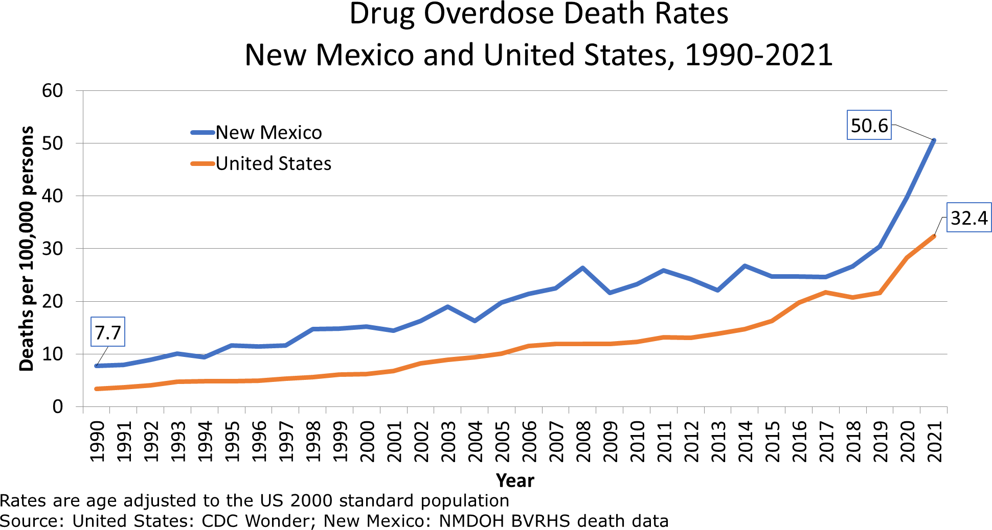

Slide 5
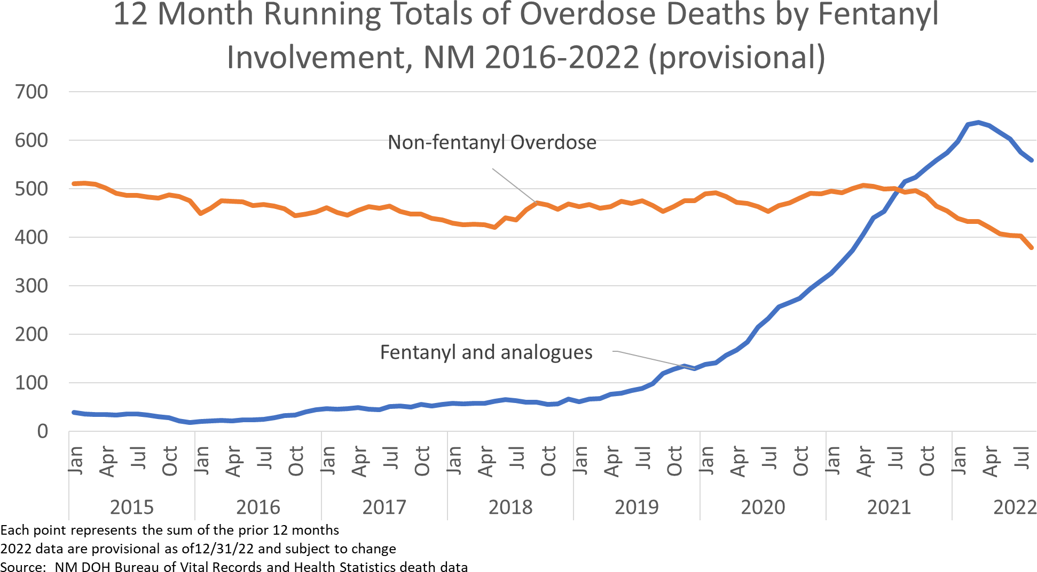

Slide 6
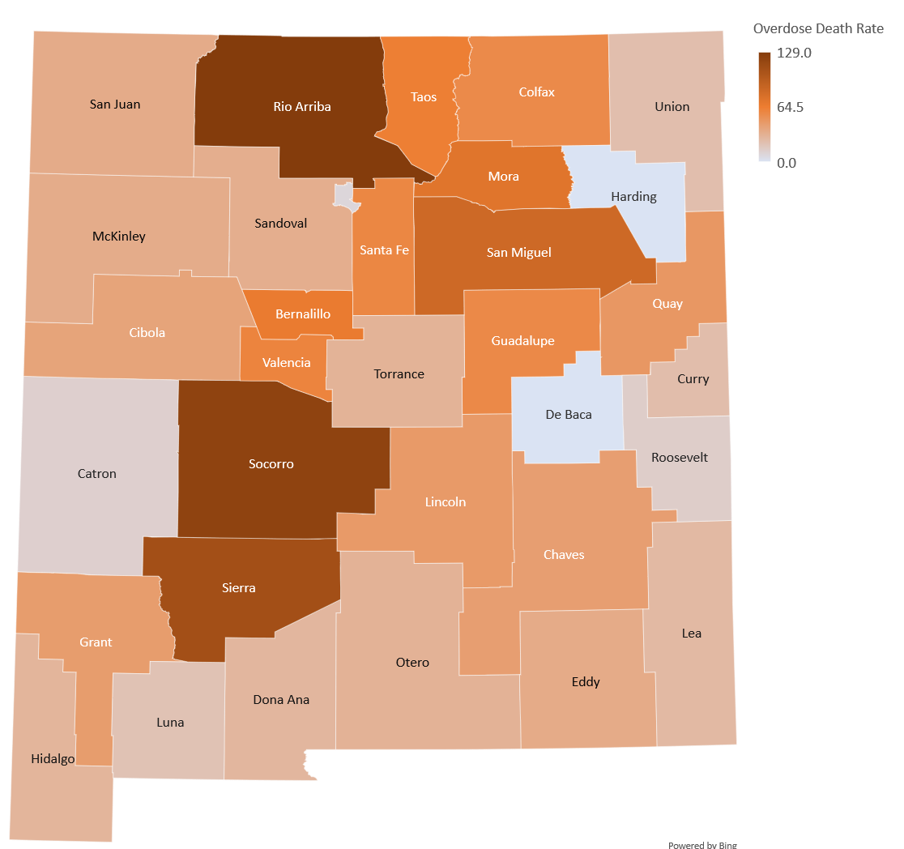
Source: NM DOH Bureau of Vital Records and Health Statistics death files; UNM/GPS population estimates

Slide 7
What MAT is

Slide 8
Medication-assisted treatment (MAT)
“Medication-assisted treatment saves lives while increasing the chances a person will remain in treatment and learn the skills and build the networks necessary for long-term recovery.”
– Michael Botticelli, former Director of National Drug Control Policy
Decreases illicit opiate use and other
criminal activity.
Decreases transmission of infectious diseases such as HIV and hepatitis C.
Decreases overdoses and drug-related mortality.
Increases
patient survival and retention in treatment.
Increases
patients’ ability to gain and maintain employment.
Source: SAMHSA

Slide 9
Comparing methadone and buprenorphine-based treatment
Office-based opioid treatment (OBOT) Outpatient clinics prescribing buprenorphine/ Suboxone® usually in rural/suburban areas. | Opioid treatment program (OTP) Outpatient clinics dispensing methadone usually in urban areas.
Emerged as new gold standard MAT over past 10 years. | Gold standard MAT for 50 years.
Buprenorphine is partial agonist. Reduces cravings. Safer than methadone. | Methadone is full agonist (can produce a “high”).
Prescription filled by a local pharmacy and taken at home by patient. | Administered primarily in office with observed dosing by provider.
Varies depending on phase of treatment (initiation, stabilization, maintenance) from twice weekly to monthly. | Daily visits. After a period of stability, patients may be able to take methadone home between visits.
Licensed provider (MD, NP, PA) assisted by office staff (RN, MA etc.) and in some cases counselors. | Clinic director (licensed), peer counselors, medical director, RN, pharmacist (few hours per week).
Operates under the provider license, no accreditation required. | Clinic is licensed by state and federal agencies and accredited by Joint Commission or CARF.
Third party reimbursement (Medicaid and commercial coverage). | Third party reimbursement (Medicaid and commercial coverage).
HISTORY
MEDICATION DESCRIPTION
MEDICATION DISTRIBUTION
VISIT FREQUENCY
STAFFING
LICENSURE & ACCREDITATION
PAYMENT

Slide 10
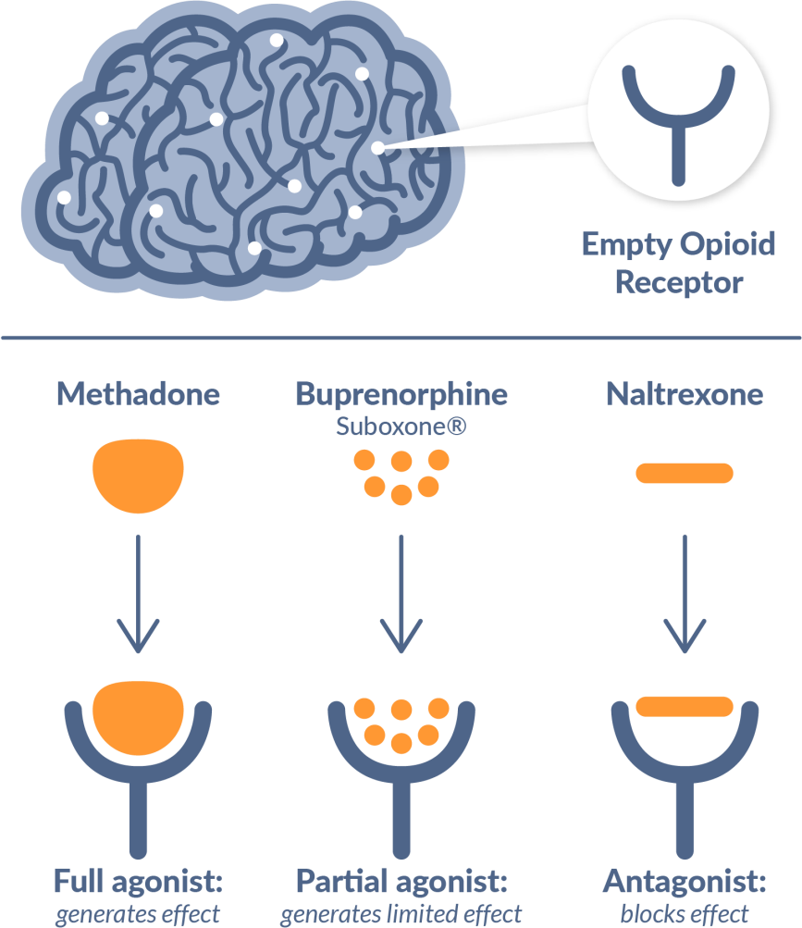
How opioid treatment medications work on the brain
The Food and Drug Administration (FDA) has approved several different medications to treat alcohol and opioid use disorders. Medications used for MAT are evidence-based treatment options and do not just substitute one drug for another.
- SAMHSA
Medications for Opioid Use Disorder:
Reduce cravings
Block the effects of opioids if used while on the medication
Prevent withdrawal
Help restore normal brain function, including memory, concentration, decision-making and thinking
Source: “Medication-Assisted Treatment Improves Outcomes for Patients with Opioid Use Disorder.” Pew Internet & American Life Project, Nov. 2016.

Slide 11
Opioid Use Disorder Treatment Protocols

Slide 12
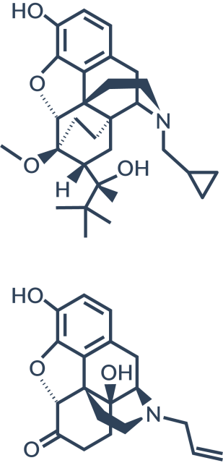
one addiction for another?
Isn’t taking Suboxone® trading
How does Suboxone® work?
Suboxone contains both buprenorphine and naloxone.
Buprenorphine attaches to the same receptors as other opioids but only partially activates those receptors. This eliminates withdrawals and cravings, which helps people feel normal.
Naloxone is an antagonist / opioid blocking medication that causes withdrawal symptoms if someone tries to abuse the medication.
A common concern and misconception associated with medication-assisted treatment (MAT) is that it substitutes one drug for another.
Research has shown that when provided at the proper dose, medications such as Suboxone have no adverse effects on a person’s intelligence, mental capability, physical functioning, or employability.
People in stable recovery who are dependent on Suboxone or other addiction medications, lead normal lives, take care of their families, maintain friendships, excel at their jobs, go back to school, and pay their bills.
Visit idealoption.com/patient-forms to download our e-book: Debunked: Top 3 Myths About Suboxone.

Slide 13
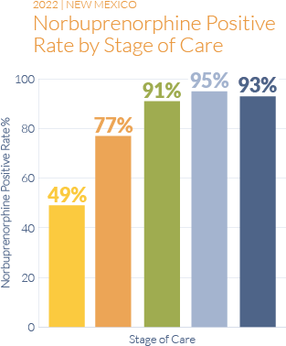
Medication adherence prevents diversion and ensures stability
Suboxone has street value as a withdrawal
management medication, not as a high-producing drug
High visit frequency and lab testing through initiation prevents diversion
Buprenorphine adherence correlates with improved treatment outcomes
Medication adherence rates improve by stage of care:
49% adherence at initiation (indicates early engagement)
77-91% adherence at stabilization
93% adherence at maintenance
Initiation ─ New patient: 2 visits every week.
Stabilization A ─ Inconsistent progress; 1 visit every week.
Stabilization B ─ Consistent progress; 1 visit every 2 weeks.
Maintenance A ─ Consistent progress; 1 visit every 3 weeks.
Maintenance B ─ Long-term progress; 1 visit per month.
Source: Ideal Option 2022 Annual Patient Outcomes Report

Slide 14
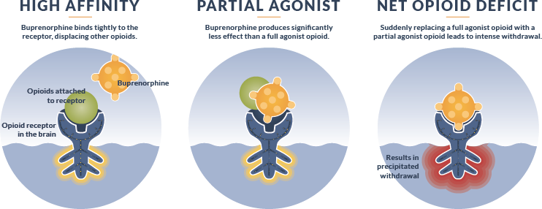
Can Suboxone Cause Precipitated Withdrawal?
Precipitated withdrawal can result when a patient takes a full dose of buprenorphine while a full agonist opioid is still occupying the opioid receptors in the brain.
With the right initiation method, precipitated withdrawal can be avoided.

Slide 15
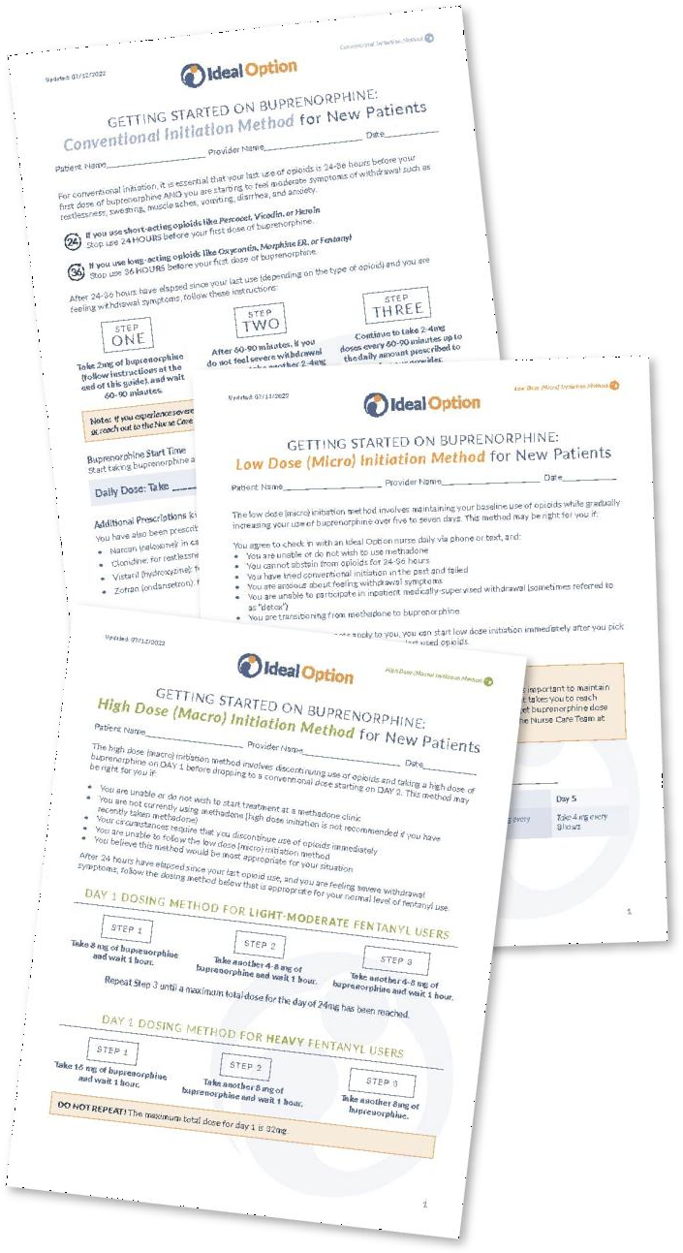
3 Methods to Safely Transition to Buprenorphine
Conventional Initiation Method
The conventional initiation method is for new patients who have abstained from opioids for 24-36 hours and are feeling moderate withdrawal symptoms before starting buprenorphine.
24H
36H
Short-acting opioids like Percocet, Vicodin, or Heroin must be
stopped 24 HOURS before the first dose of buprenorphine.
Long-acting opioids like Oxycontin, Morphine ER, Methadone or Fentanyl must be stopped 36 HOURS before the first dose of buprenorphine.
Low Dose (Micro) Initiation Method
The low dose (micro) initiation method is for new patients who have been directed by their provider to maintain their baseline use of opioids while gradually increasing their dose of buprenorphine over five to seven days.
High Dose (Macro) Initiation Method
The high dose (macro) initiation method is for new patients who have been directed by their provider to stop all use of opioids and start immediately on a high dose of buprenorphine.

Slide 16
Stages of Treatment
Our goal at Ideal Option is to get patients stabilized onto their prescribed medication and into long-
term recovery. This chart shows how patients make progress from one stage of treatment to the next.
Initiation
Visits Every Week
Day Rx
Patient is new, restarting treatment after a lapse, or not yet stabilized on buprenorphine.
Stabilization A
1 Visit Every Week 7 Day Rx
Patient is starting to feel stable on buprenorphine and has reduced/stopped their use of opioids but may still be using other substances.
Stabilization B
1 Visit Every 2 Weeks
14 Day Rx
Patient is starting to feel stable on buprenorphine and has reduced/stopped their use of opioids but may still be using other substances.
Maintenance A
1 Visit Every 3 Weeks
21 Day Rx
Patient is completely stable on buprenorphine and abstinent from all non- prescribed substances and alcohol.
Maintenance B
1 Visit Every Month 28 Day Rx
Patient has long-term stability on buprenorphine and abstinence from all non-prescribed substances and alcohol.
No Withdrawal Symptoms
Reduced Cravings
Taking Buprenorphine*
Reduced Opioid Use*
No Withdrawal Symptoms
No Cravings
Taking Buprenorphine*
No Opioid Use*
No Non-Prescribed Benzos or Sedatives*
No Withdrawal Symptoms
No Cravings
Taking Buprenorphine*
No Opioid Use*
No Non-Prescribed Benzos or Sedatives*
No Stimulants
No Withdrawal Symptoms
No Cravings
Taking Buprenorphine*
No Opioid Use*
No Non-Prescribed Benzos or Sedatives*
No Stimulants
Graduation
Criteria
* Verified by urine drug testing

Slide 17
Case Study #1

Slide 18
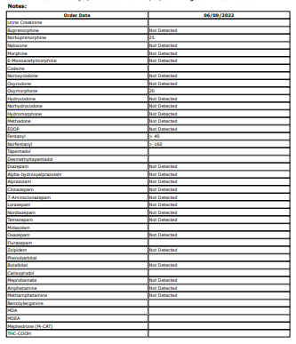
Background
48-year-old female
First seen on 6/9/2022
30+ years of Heroin, Fentanyl, and Meth use
Initial UA screening: Norbuprenorphine, Fentanyl, Norfentanyl
Medical History:
Anemia
NIDDM
COPD
Depression
Anxiety
PTSD
Social History:
Widowed x2
Lives in multi-generational housing
Childhood trauma
Started micro-initiation

Slide 19
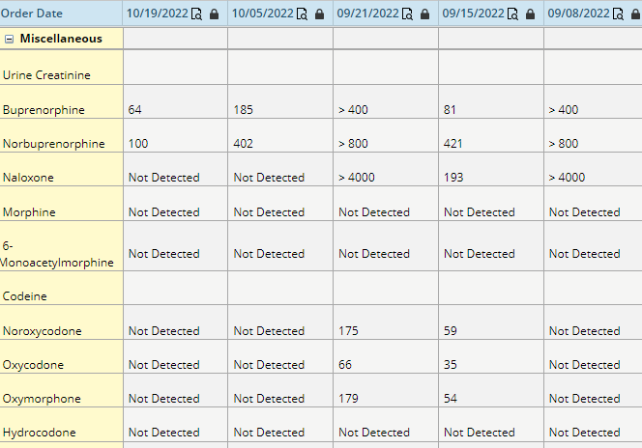
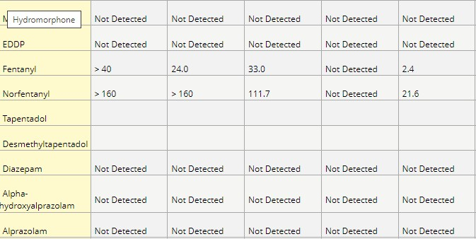
9/18 pt presented to office with bruises; crying – shared DV situation with elderly mother with dementia. Arranged emergency shelter with family; triggered relapse with heroin
Spoke with care team and got ok to proceed with starting Sublocade under harm reduction.
10/19 – again in discussion with patient
and care team.
patient adamant no fentanyl; under harm reduction she continued sublocade and q 2-week appts

Slide 20
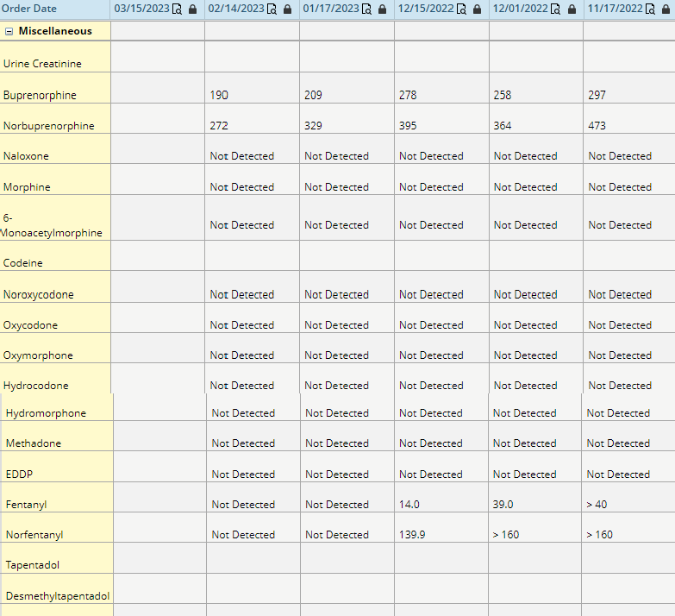
11/17 – patient held family meeting/
intervention.
Son-in-law smoking fentanyl and asked to leave house.
Deep clean of house done.

Slide 21
Case Study #2

Slide 22
Background
34-year-old male
First seen on 1/26/2023
Long term recreational opioid use until COVID-19 when a ‘friend gave him what he thought were Percocets – got hooked on fentanyl.
Medical History:
Anxiety
Family history of OUD (father and brother)
Social History:
School Teacher, Perusing Masters Degree
Father of 2

Slide 23
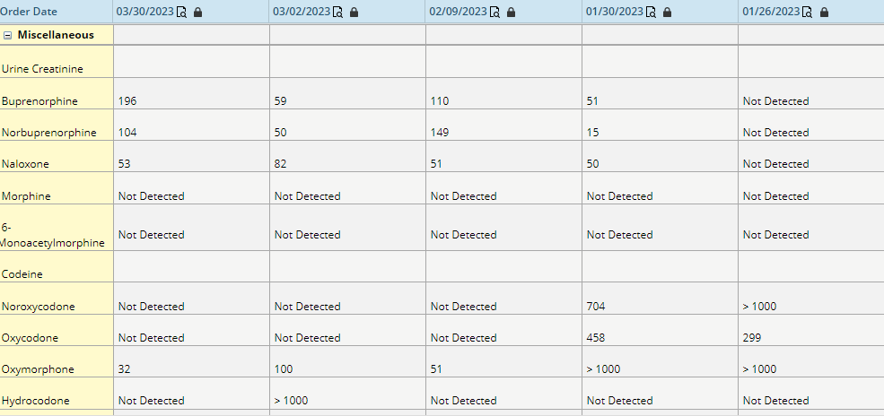
In December transitioned himself from fentanyl to Oxycontin (spent $42,000) in 2 month; went to PCP for rx of suboxone
when he heard X waiver no longer required
Due to work/school schedule agreement made with patient for q 2-week appts via video
3/2/2023 appt patient came in “feeling defeated”; went to PCP office – “was told now it is spring break aren’t you going to get off of it”

Slide 24
Case Study #3

Slide 25
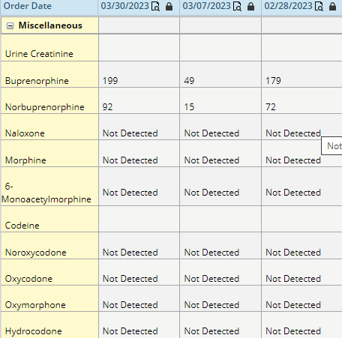
30-year-old male
First seen on 5/4/2022
Medical History: Bipolar 1, noticed that he relapsed when he stopped his medications or could not make it in for appts.
10/17 – Discussed options for sublocade
First sublocade injection: 11/2022
Second sublocade injection 12/2022 and then lost
for follow-up.
Patient returned to clinic on 2/28/2023 reporting no cravings or relapse.
3/30/2023: Restarted sublocade injections.

Slide 26
Case Study #4

Slide 27
Background
30-year-old female
First seen on 12/18/2022
Medical History:
17-year history of OUD including IV heroin use and smoking fentanyl.
Dosing: conventional dosing NTE 16 mg

Slide 28
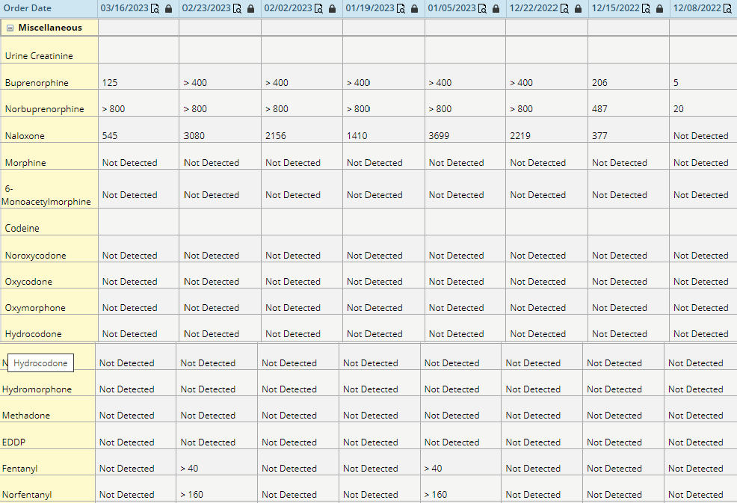
2/2/2023 got job as head cook in kitchen at local NH.
2/23/2023 relapsed after fight with new mother-in- law
Presented at office when it opened crying.
contract stating 2 x a week visit for 2 weeks.

Slide 29
Case Study #5

Slide 30
Background
First seen on 10/24/2022
Medical History:
Alcohol use disorder (AUD), anxiety, and hypogonadism.
Dosing: conventional dosing 8mg a day.
Uninsured
Case involves Kratom at 300mg per day.

Slide 31
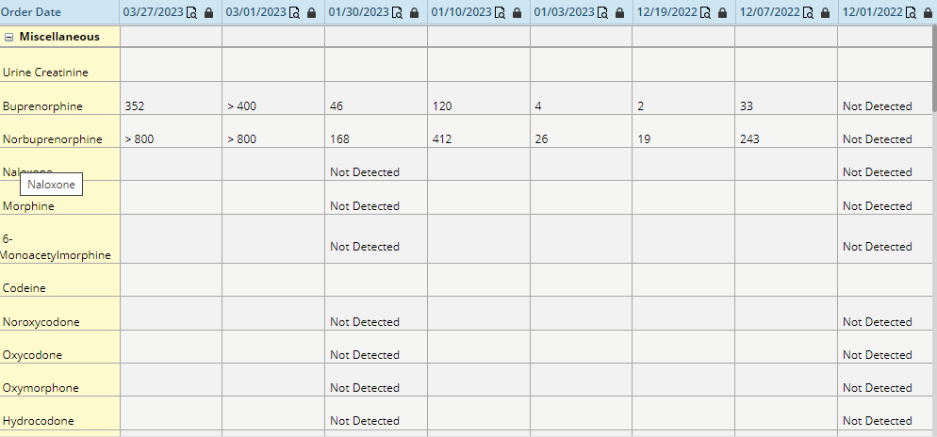
After 1/30 patient stopped coming d/t cost of care; returning in March d/t withdraw symptoms he suffers when attempting to titrate down.

Slide 32
Clinical Outcomes
Treatment outcomes based on lab testing data performed on 14,961 patients receiving substance use disorder treatment from Ideal Option during 2022.

Slide 33
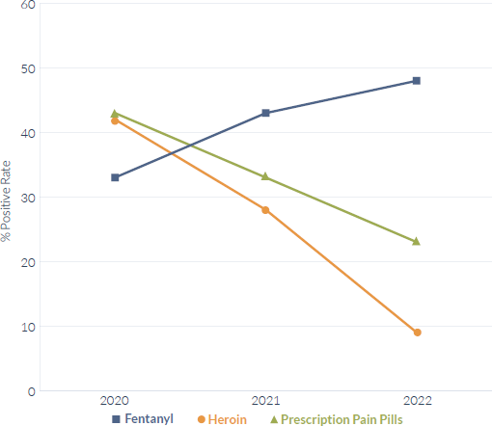
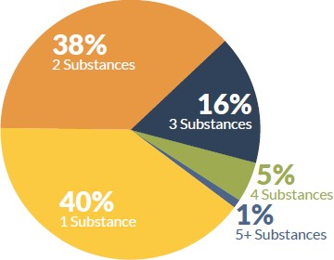
Substance Use Trends
Source: Ideal Option 2022 Annual Patient Outcomes Report

Slide 34
Low barrier and evidence-based means more patients start treatment, stay in treatment, and achieve stable recovery.
No Wait Lists
Patients are scheduled for their first appointment within 1-3 business days. Warm handoffs may be fast-tracked through our referrals team.
Medicaid Accepted
Most forms of insurance including Medicaid and Medicare are accepted. Payment plans and financial counseling is available for uninsured patients.
Outpatient
Our convenient outpatient locations allow patients to maintain relationships with family and take advantage of training and employment opportunities.
Non-Judgmental
While return-to-use episodes will trigger a review of a patient’s treatment plan, patients are never penalized or expelled.

Slide 35
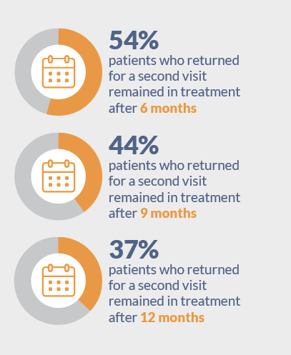
76% of patients return for a 2nd visit.

Slide 36
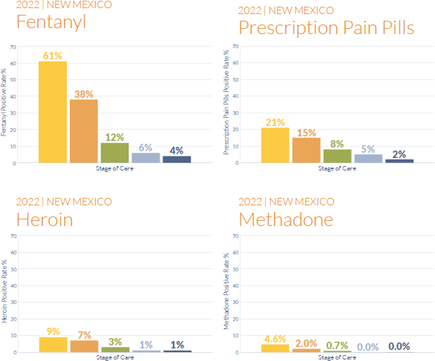
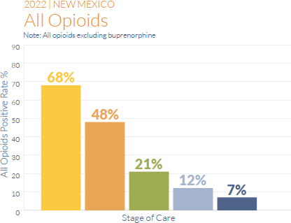
Treatment Outcomes
Initiation ─ New patient: 2 visits every week.
Stabilization A ─ Inconsistent progress; 1 visit every week.
Source: Ideal Option 2022 Annual Patient Outcomes Report
Stabilization B ─ Consistent progress; 1 visit every 2 weeks.
Maintenance A ─ Consistent progress; 1 visit every 3 weeks.
Maintenance B ─ Long-term progress; 1 visit per month.

Slide 37
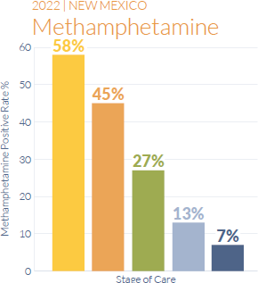
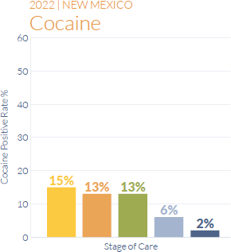
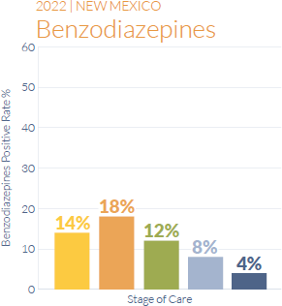
Treatment Outcomes
Initiation ─ New patient: 2 visits every week.
Stabilization A ─ Inconsistent progress; 1 visit every week.
Source: Ideal Option 2022 Annual Patient Outcomes Report
Stabilization B ─ Consistent progress; 1 visit every 2 weeks.
Maintenance A ─ Consistent progress; 1 visit every 3 weeks.
Maintenance B ─ Long-term progress; 1 visit per month.

Slide 38
Warm Hand-Off Program
Dedicated 24/7 referral hotline for community partners and providers to initiate warm handoffs.
Warm handoff patients are fast-tracked through intake and every
effort is made to schedule their first appointment within 24 hours.
Direct billing for all forms of insurance including Medicaid and Medicare, payment plans, and financial counseling.
How to Refer a New Patient
Collect the patient’s name, date of
birth, and a contact phone number.
Call our 24/7 referral hotline at
1-844-GO-IDEAL (1-844-464-3325)
or visit idealoption.com/refer.
Write down the appointment time and clinic address and give to patient.
Need an ROI? Complete it online at:
idealoption.com/patient-forms
Request a Referral Kit!
Community partners and healthcare providers can request a referral kit at hello@idealoption.net or idealoption.com/contact-us.

Slide 39
Athena Huckaby AthenaHuckaby@idealoption.net
Thank You
Laura Wells laurawells@idealoption.net

